Slide 1


Automating Scan-to-BIM for Telecom Site Planning
Chair of Circular Engineering for Architecture
Jeffrey Leisi
Final Presentation
Bachelor’s Thesis
26.05.2025
Notes:
Hi everyone, welcome to my final presentation on automating Scan-to-BIM for telecom site planning.
It’s a collaboration with Axians, one of the leading ICT companies in Switzerland.
I’m glad that their innovation manager, Jean-Charles, can join us today.

Slide 2
Agenda
Research Foundation
Motivation
State of the Art
Problem Statement
Proposed Solution
Research Question
Methodology (DSRM)
Research Activities
Problem Identification & Objectives
Design and Development
Demonstration
Evaluation
Communication
Notes:
The presentation is divided into two parts.
█ First, I will introduce the conceptual foundation of the research.
█ Then, I will walk you through the steps I took over the past three months.

Slide 3
Part 1: Research Foundation

Slide 4
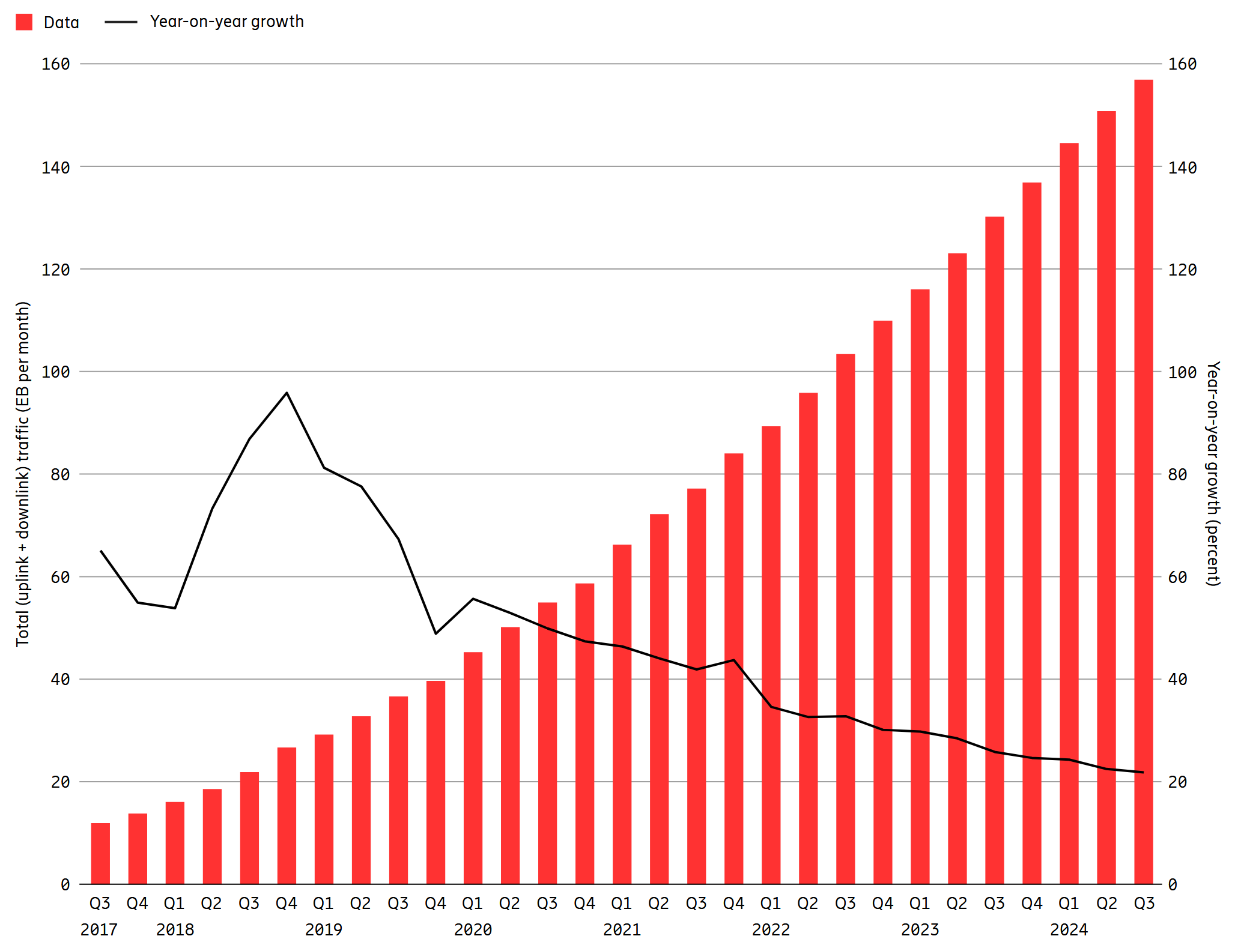
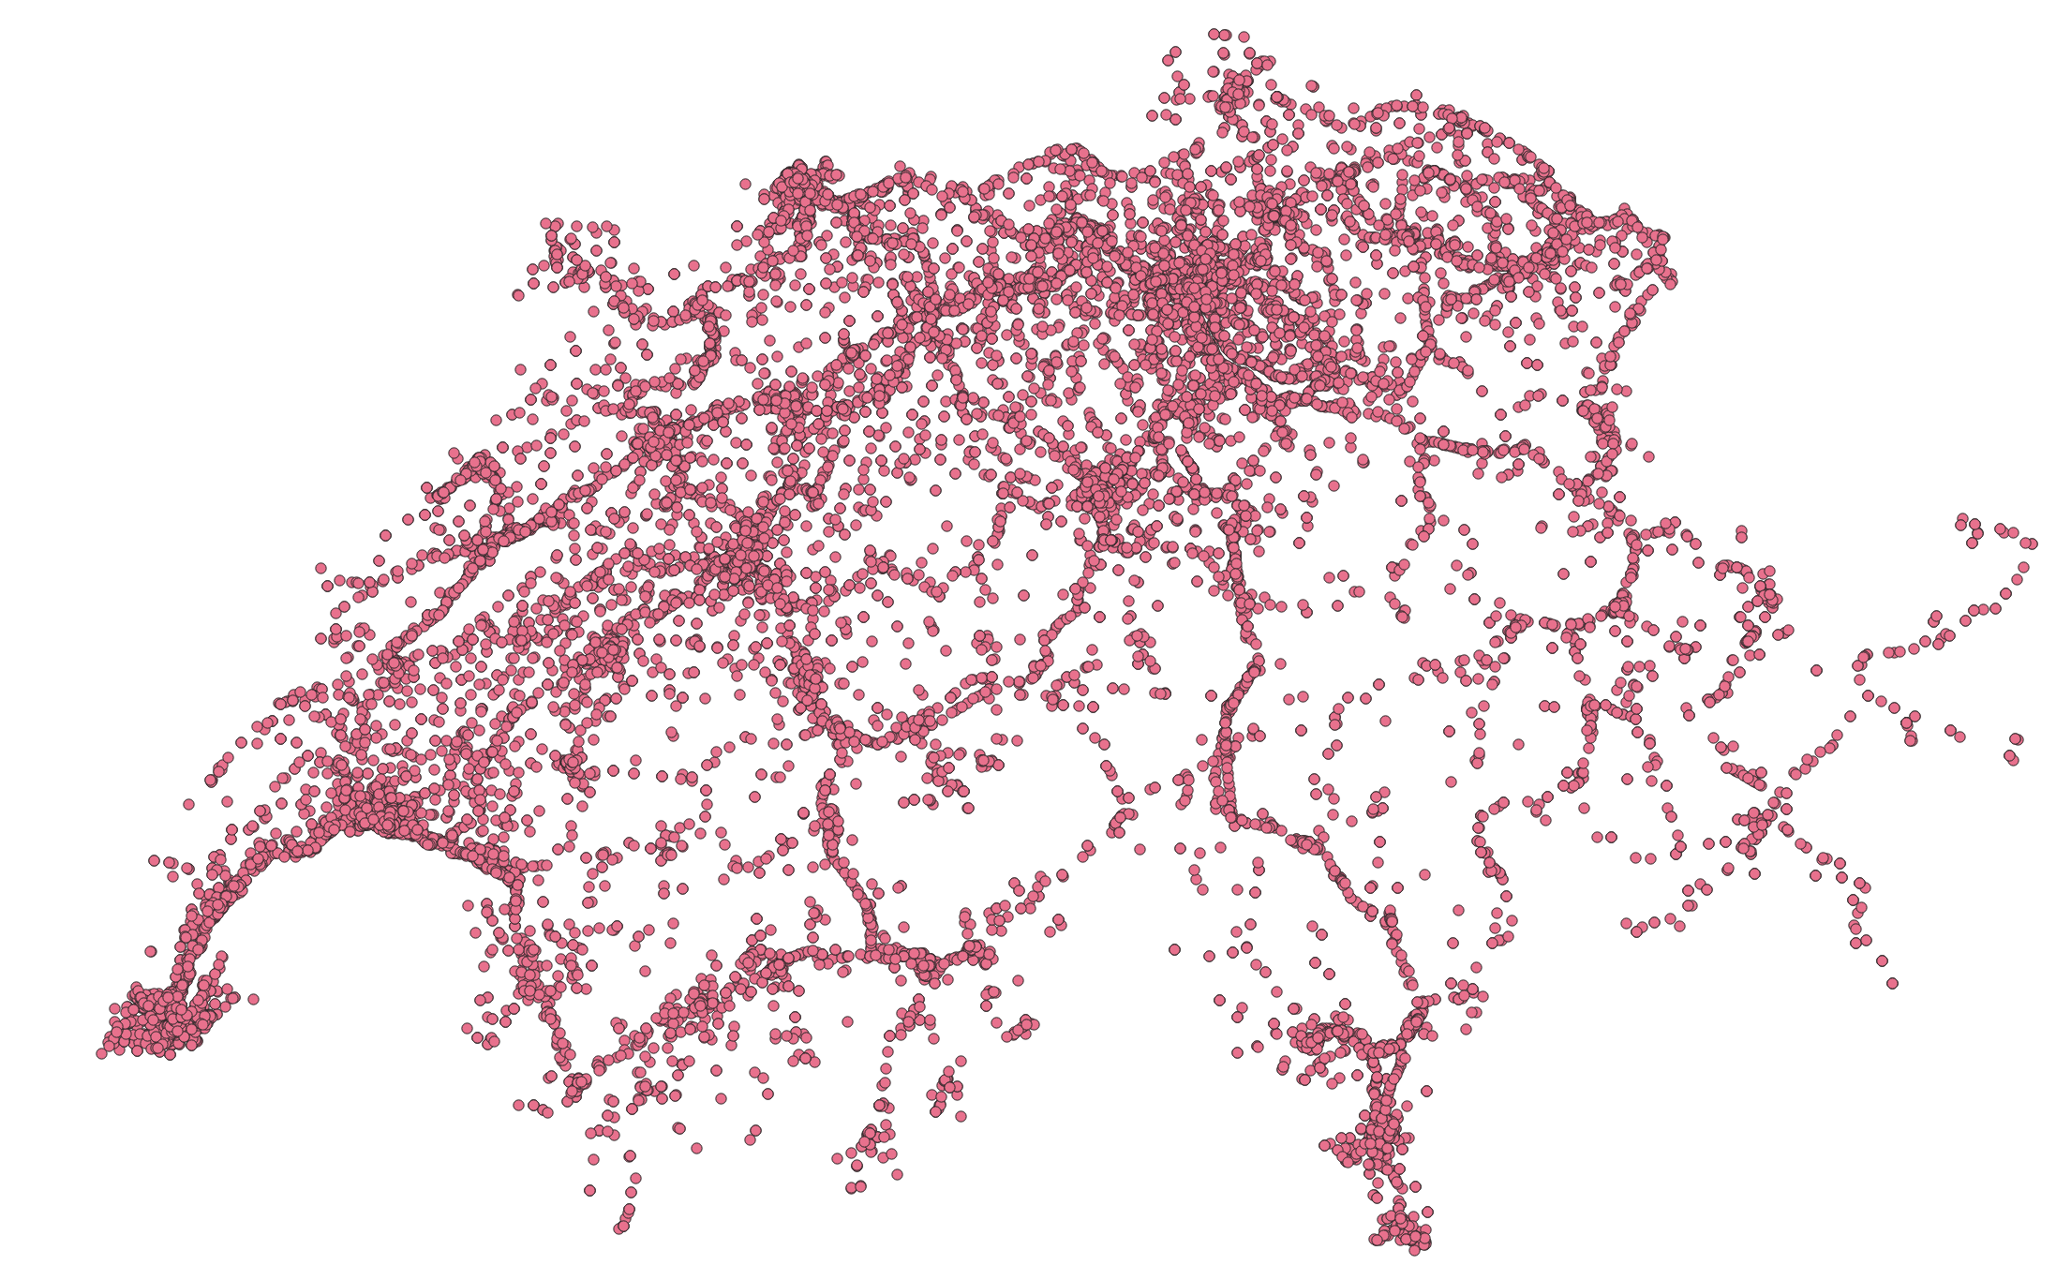
Motivation
Mobile data traffic increases
Source: Ericsson Mobility Report (November 2024)
Notes:
The latest numbers from Ericsson have shown that global mobile data traffic is still growing rapidly.

Slide 5
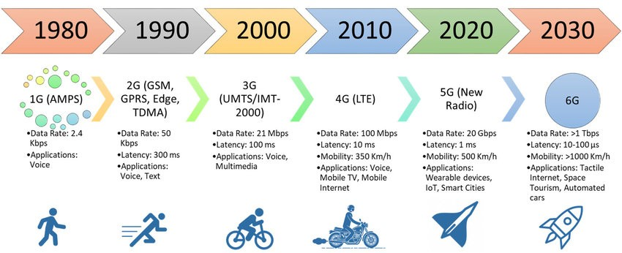
Motivation
Currently relevant
Mobile data traffic increases
New technologies (shift toward higher frequency bands)
6G
Source: https://www.linkedin.com/pulse/understanding-5g-glimpse-6g-evolution-connectivity-dr-manpreet-puri
Notes:
Because of that trend, a new mobile network generation is introduced roughly every 10 years. Currently, 4G and 5G are the most relevant technologies. Swisscom will shut down 3G at the end of this year.
To increase data throughput, newer technologies tend to use higher frequency bands.

Slide 6
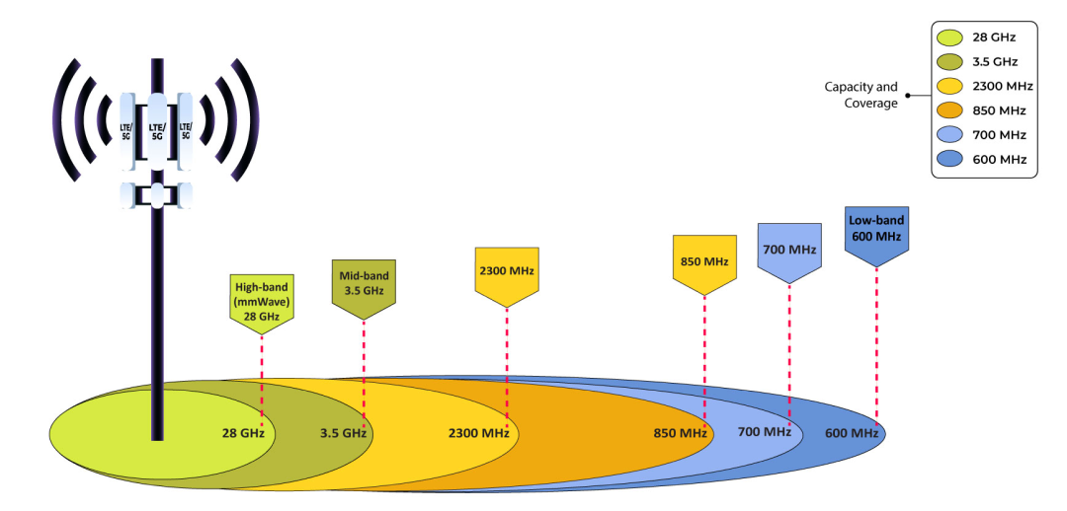
Motivation
Mobile data traffic increases
5G (high band CH)
4G (high band CH)
New technologies (shift toward higher frequency bands)
Decrease in range (stronger atmospheric attenuation)
Source: https://jethrojeff.com/
Notes:
Higher frequencies have shorter wavelengths, which reduce the signal range.
That’s why a denser antenna network is required.

Slide 7
Motivation
Mobile data traffic increases
New technologies (shift toward higher frequency bands)
Decrease in range (stronger atmospheric attenuation)
More antenna sites required
~(7,500 new 5G sites: CHF 3.2 bn)
Large-scale deployment calls for efficient planning strategies.
Status quo: ~15,000 sites (> 5 W)
Source: Own GIS analysis based on data from https://data.geo.admin.ch/browser/index.html#/collections/ch.bakom.standorte-mobilfunkanlagen?.language=en
Notes:
Currently, there are about 15,000 macro cells in Switzerland, and several thousand more will be required for full 5G coverage.
So, there is a high demand for efficient solutions for cell site planning.

Slide 8
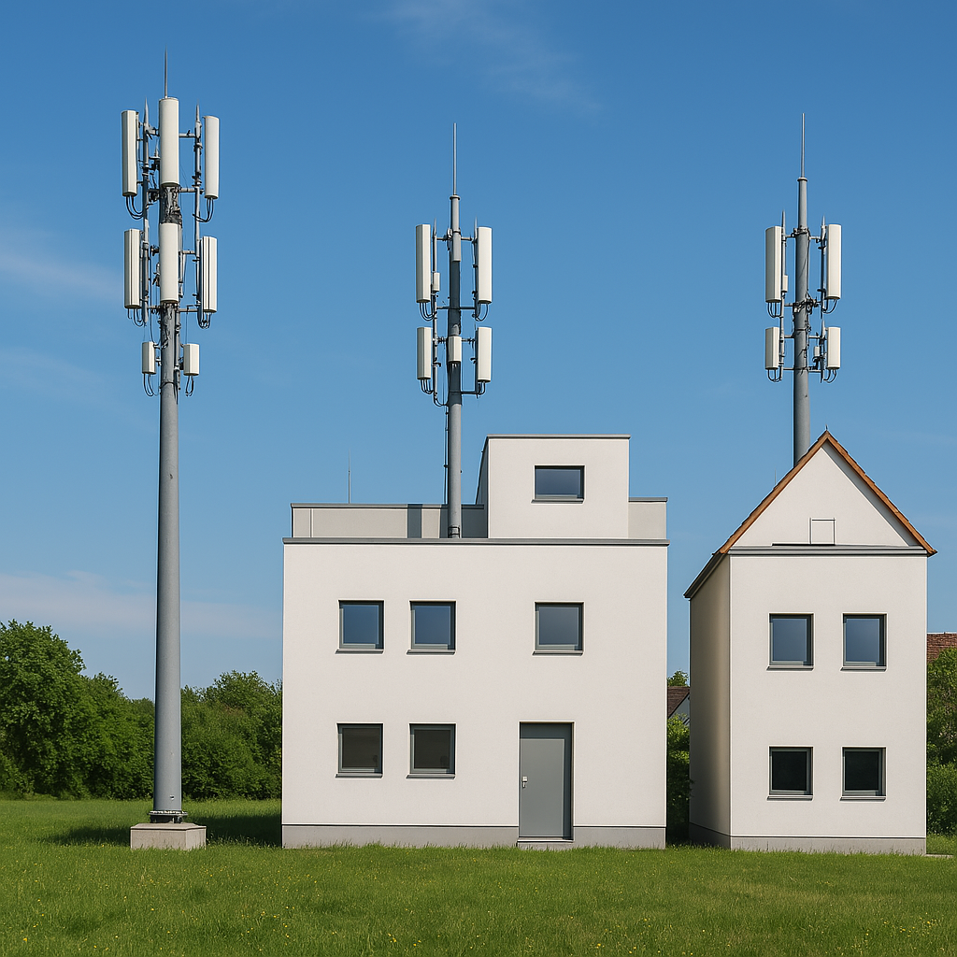
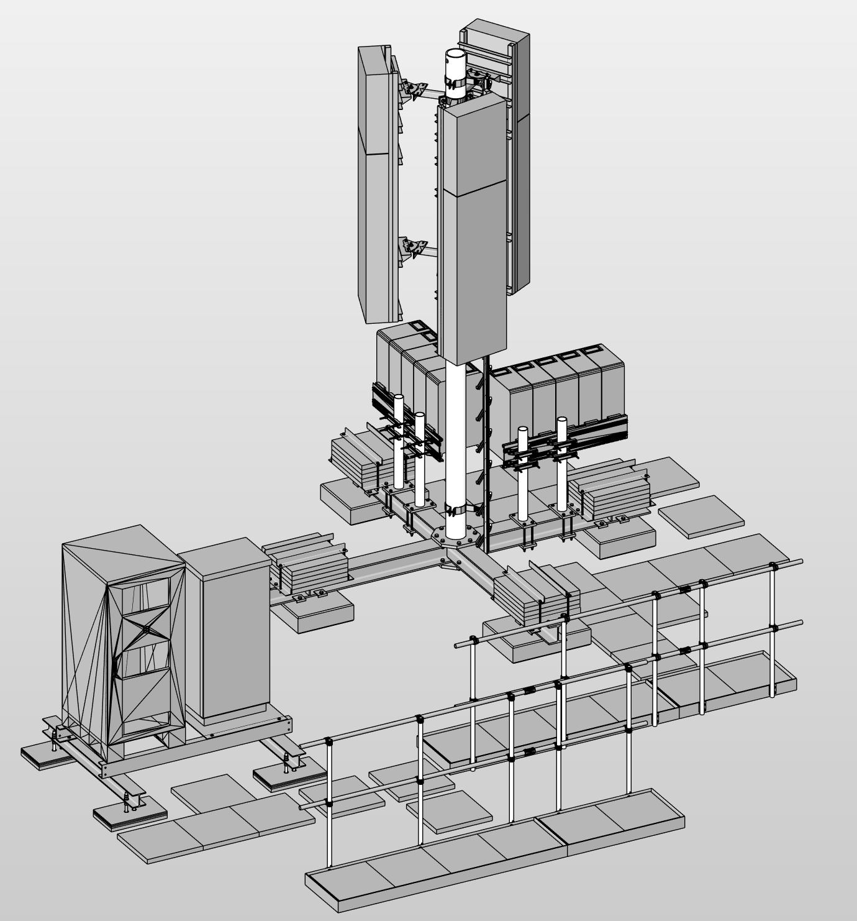
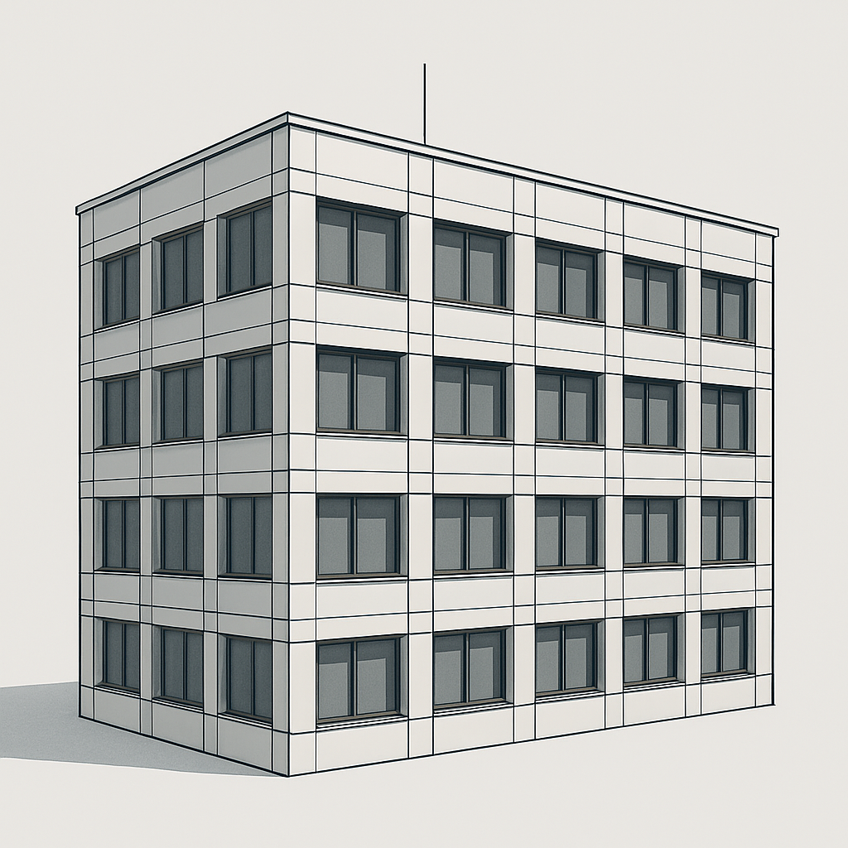
Definition: Cellular Site
Base Station
Antennas
Pole
+
=
Thesis focus
Steel structures
Radio Access Network (RAN) Equipment
Building
Rooftop Site
mainly urban areas
Greenfield Site
mainly rural areas
Notes:
A site consists normally of steel structures and electronic equipment. And if these components are installed on a roof, it’s called a rooftop site.
█ If the antennas are mounted on tower it’s called a greenfield site.
█ However, the focus of this thesis is on the building of rooftop sites.

Slide 9
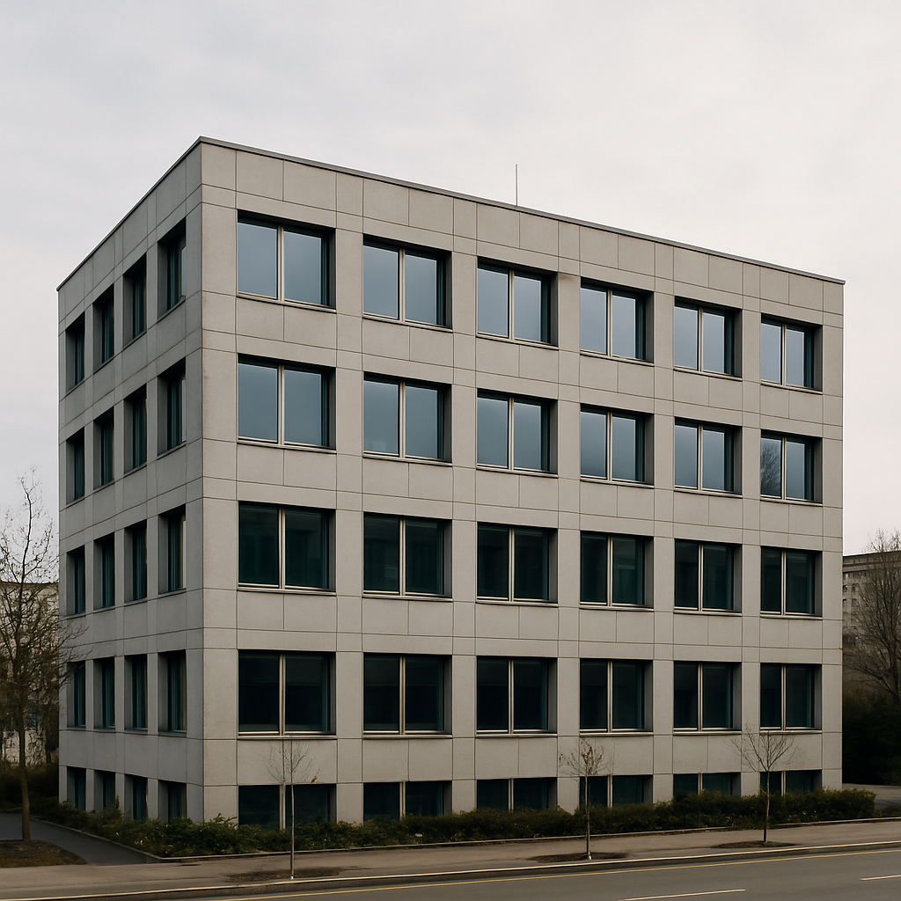
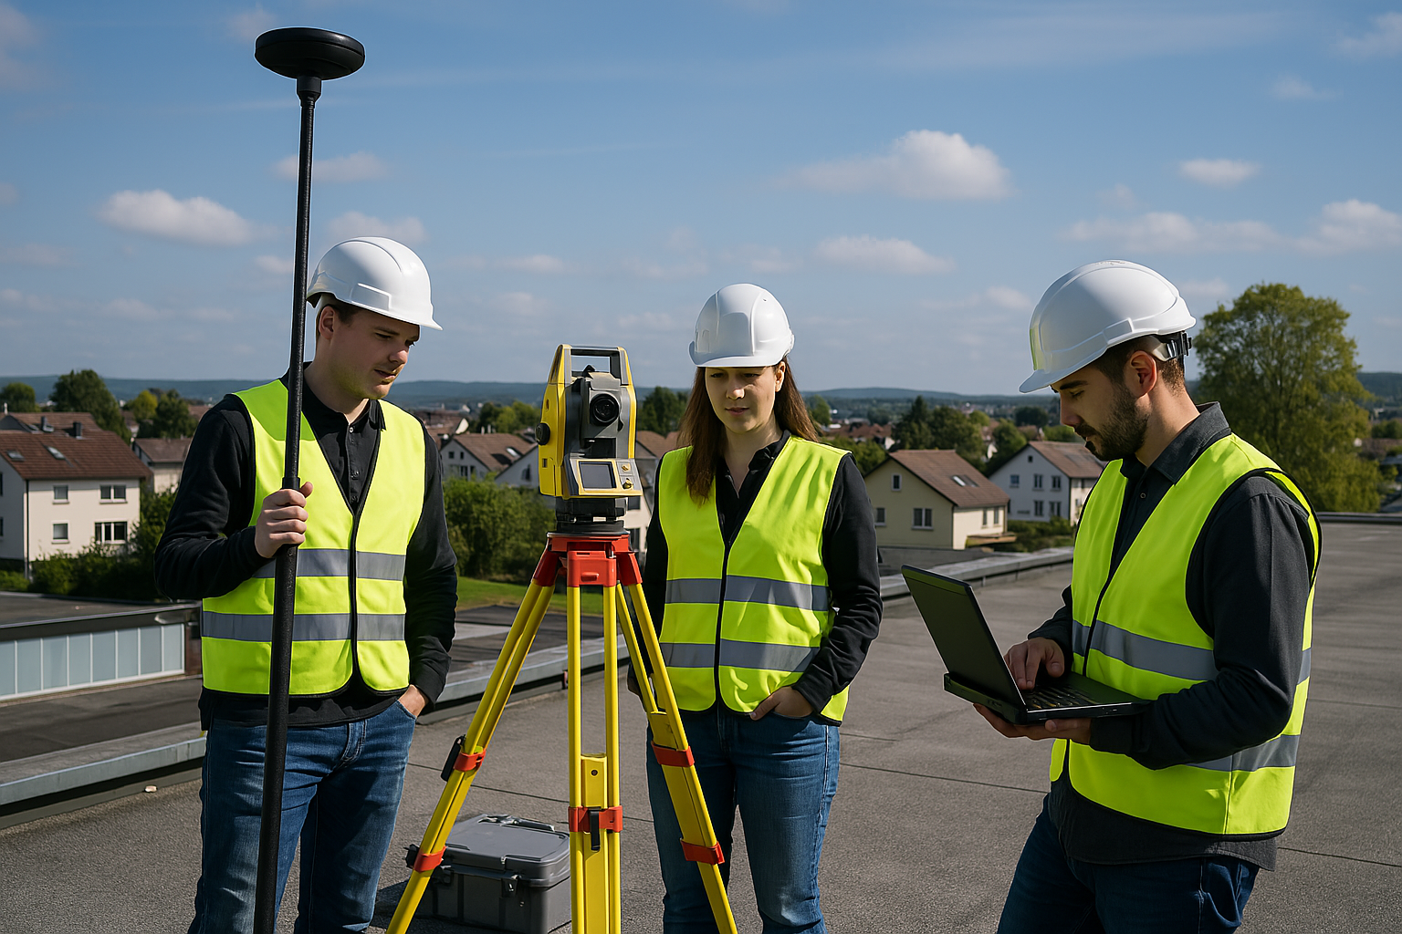
State of the Art: Conventional Site Planning
Site Survey
Schematic Design
Technical Design
Execution & Operations
Building Permit
Tasks
Inspection of the site:
Drone capture
Geodetic survey (GNSS, total station)
Organize existing building drawings
GNSS: Global Navigation Satellite System, positioning system
Total Station: Instrument for precise spatial measurement
Notes:
Now, I would like to introduce you into the current planning workflow.
First, the provider (let’s say Swisscom) searches for a rentable spot on a roof.
After that, a site survey is carried out.
Normally, this includes a lot of measurements.
For example, a drone captures the environment for radiation simulations.

Slide 10
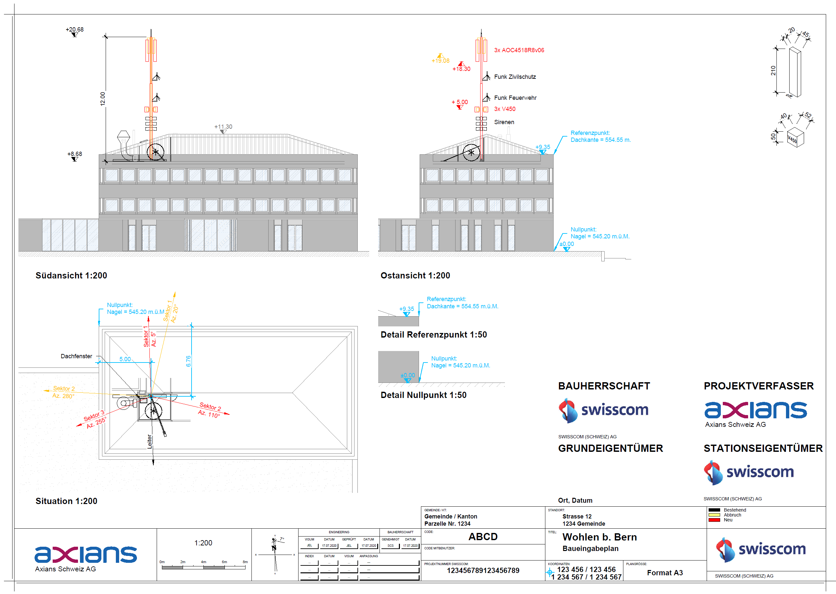
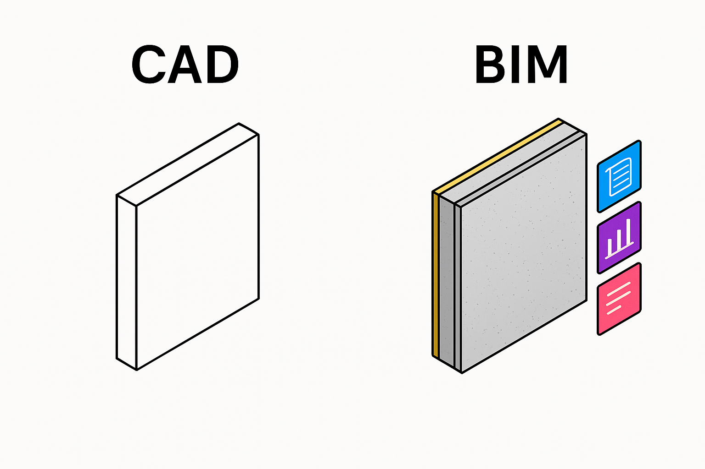
State of the Art: Conventional Site Planning
Site Survey
Schematic Design
Technical Design
Execution & Operations
Building Permit
CAD
Tasks
Create CAD drawing for building permit:
Scanning of paper building drawings
CAD-vectorization of digitalized building drawing (tracing)
CAD (Computer-Aided Design): Software for 2D/3D drawings
geometry
Notes:
After that, they need to create building views for the permit application.
For the drawing they use 2D CAD.
CAD drawings are a simple collection of geometric primitives — like lines. These lines don’t contain any semantic information; they are often called “dumb lines.”
If they’re lucky, they have access to paper drawings, which they can scan and trace.
Otherwise, they have to redraw the façade from scratch.

Slide 11
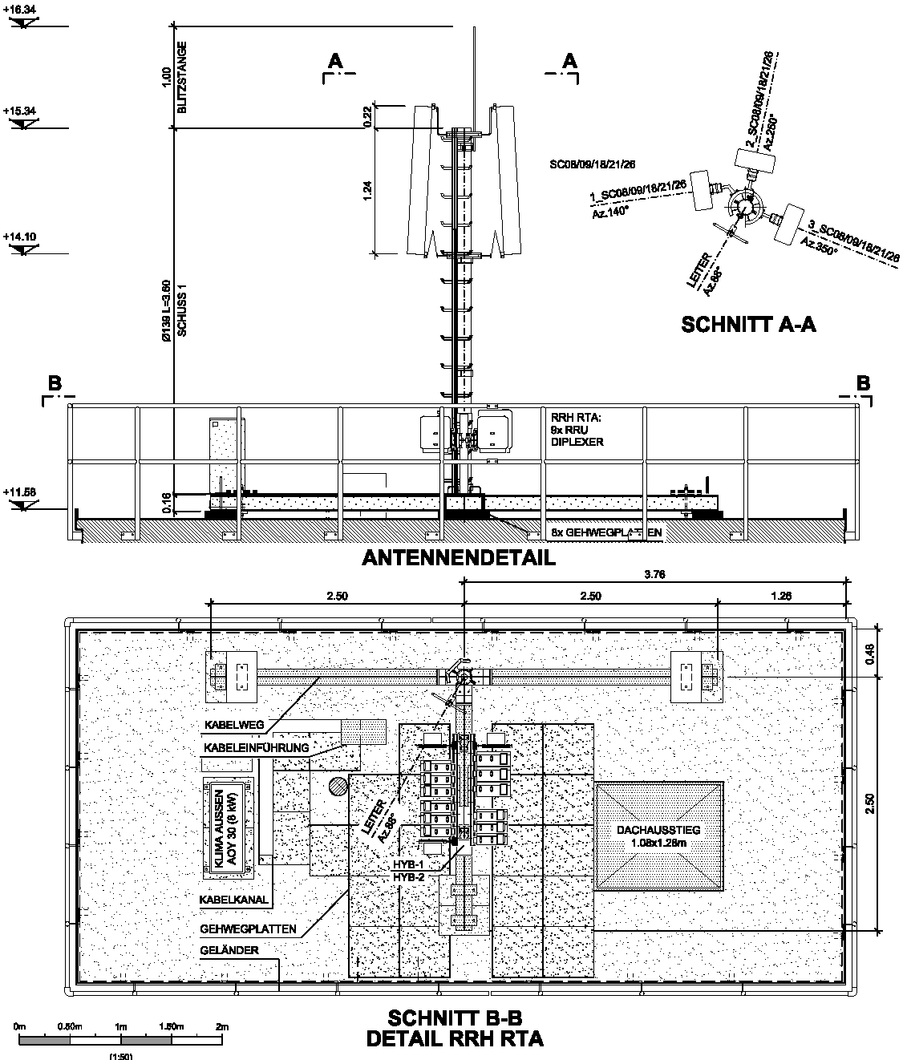
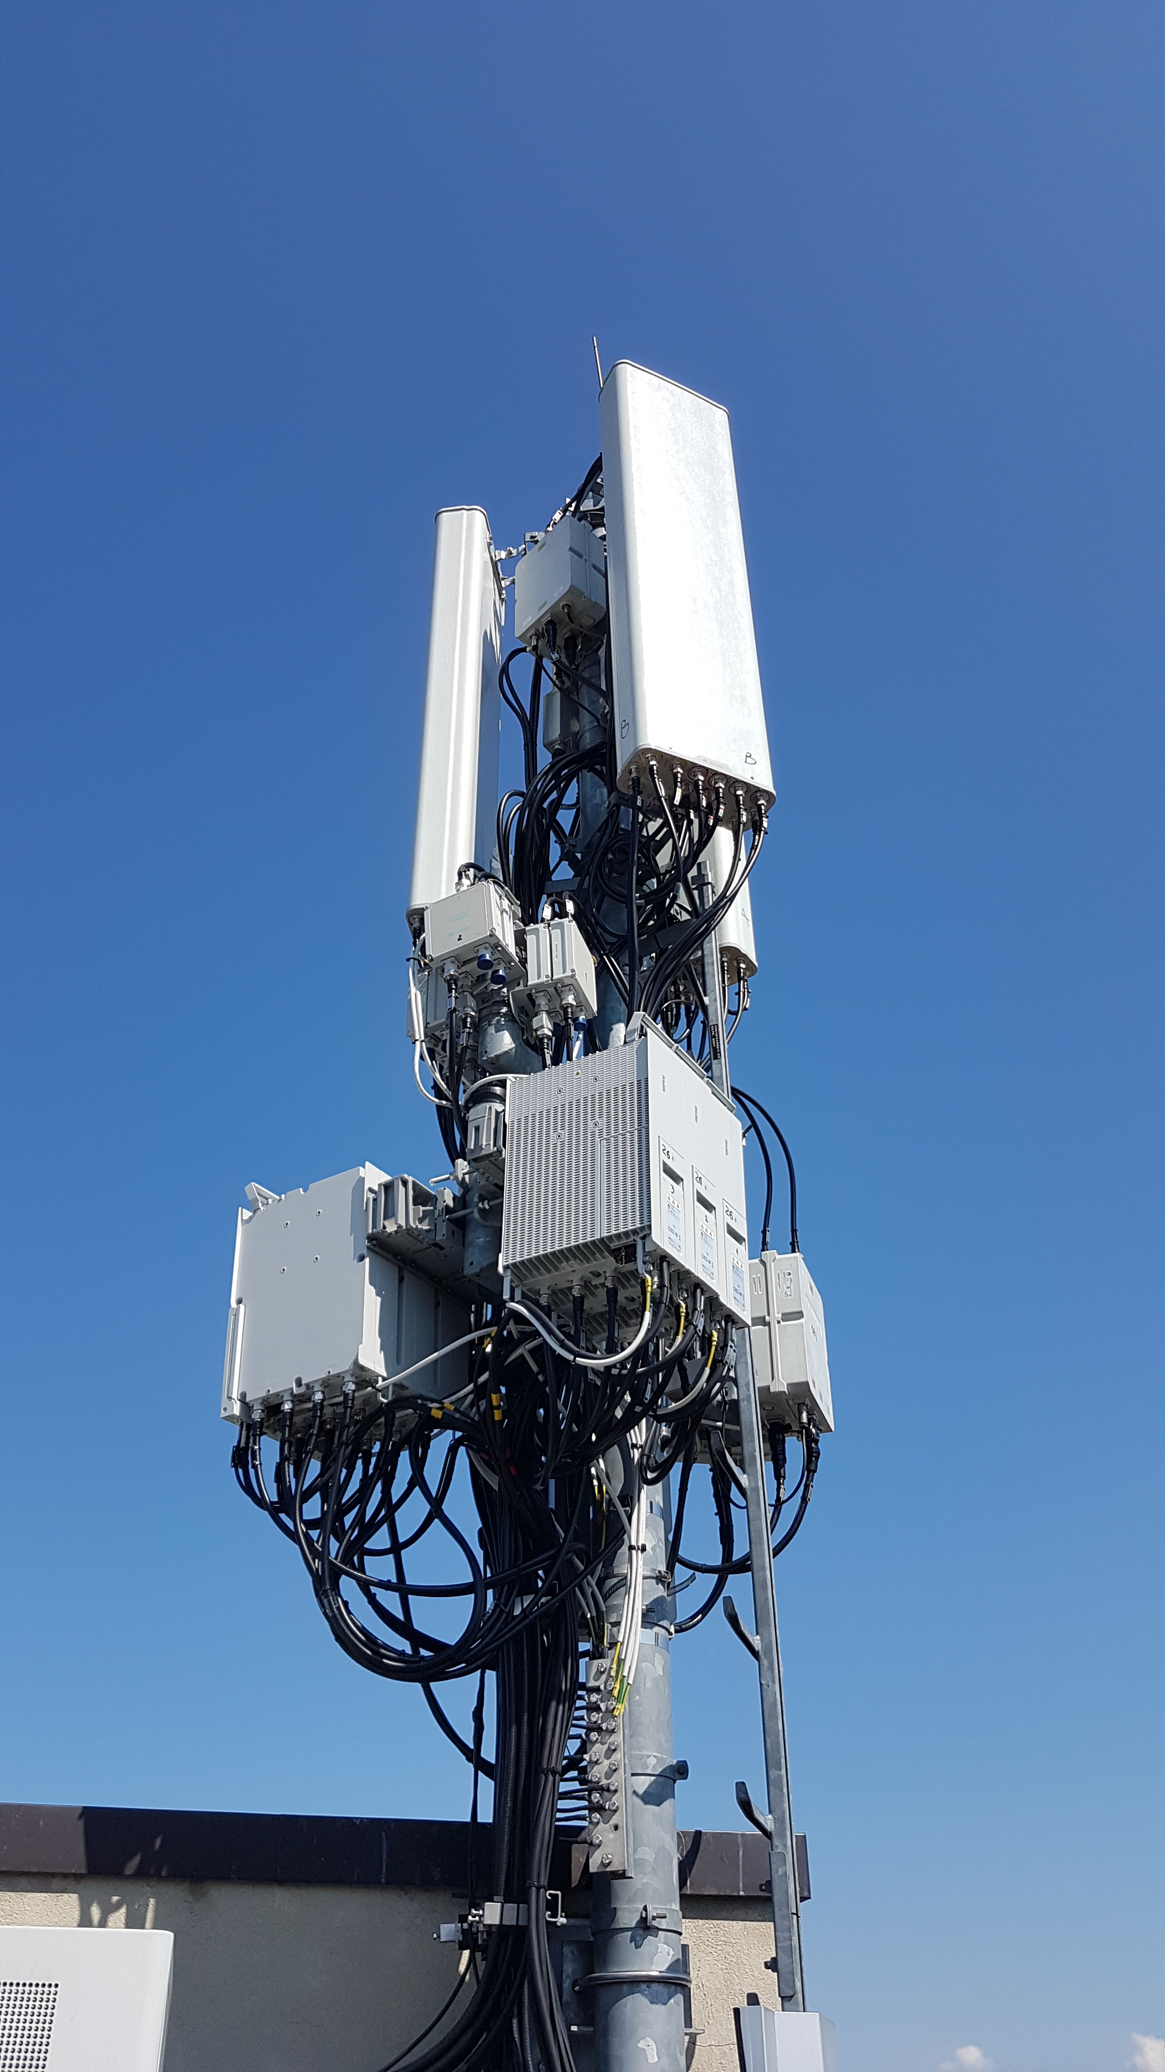
State of the Art: Conventional Site Planning
Site Survey
Schematic Design
Technical Design
Execution & Operations
Building Permit
CAD
BIM
Tasks
Create BIM drawing for execution:
Steel structure and RAN equipment
Derivation of bills of materials
BIM (Building Information Modeling): Planning method with a smart 3D model
geometry +
information
High component density → BIM
Notes:
After the building permit is approved, execution planning begins.
At this stage, component density is often high — and working in 2D becomes increasingly difficult.
To manage this complexity, they use 3D BIM, which goes a step further by adding semantic information to the geometry. The elements are no longer just simple lines — they represent complete components, like an entire antenna.
Once the model is built, you can generate 2D drawings from it.

Slide 12
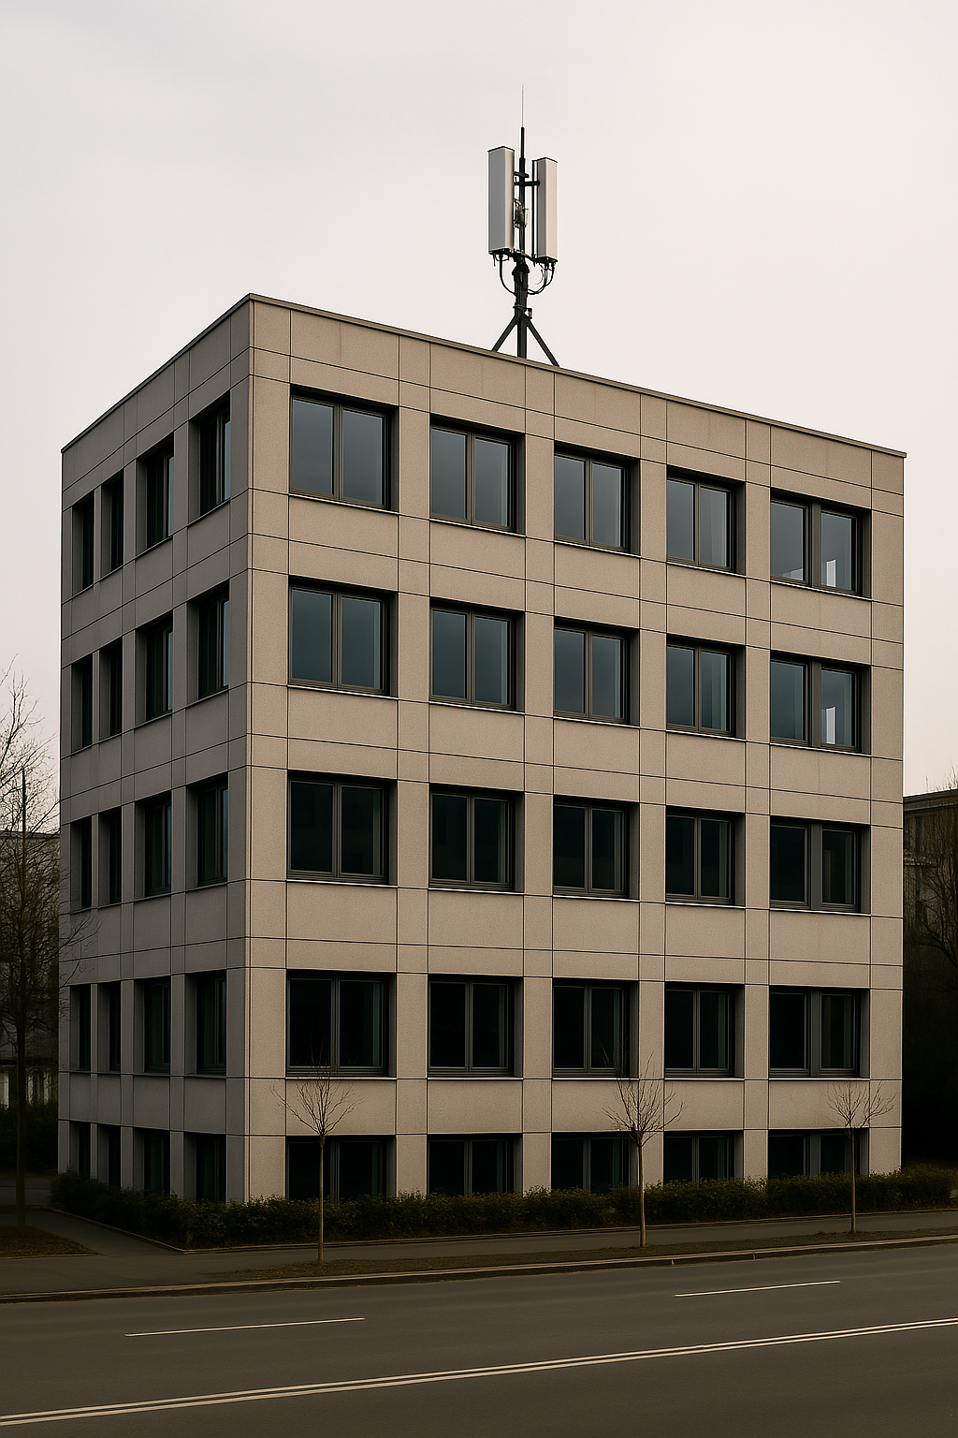
State of the Art: Conventional Site Planning
Site Survey
Schematic Design
Technical Design
Execution & Operations
Building Permit
CAD
BIM
Tasks
Site Construction
Drawing adjustment (in case of changes)
Notes:
After the site is built, it stays in operation for many years.
Any technical upgrades during this time are usually documented in CAD again.

Slide 13
Problem Statement
Site Survey
Schematic Design
Technical Design
Execution & Operations
Building Permit
CAD
BIM
CAD
Challenges
Schematic design (CAD): Labor-intensive and highly dependent on third parties
Technical design (BIM): No BIM context available from the schematic design phase
Notes:
The workflow comes along with some challenges.
First, the reconstruction of the building is labor-intensive with a high dependence on the building owner
Second, there is no BIM context available for the technical design.

Slide 14
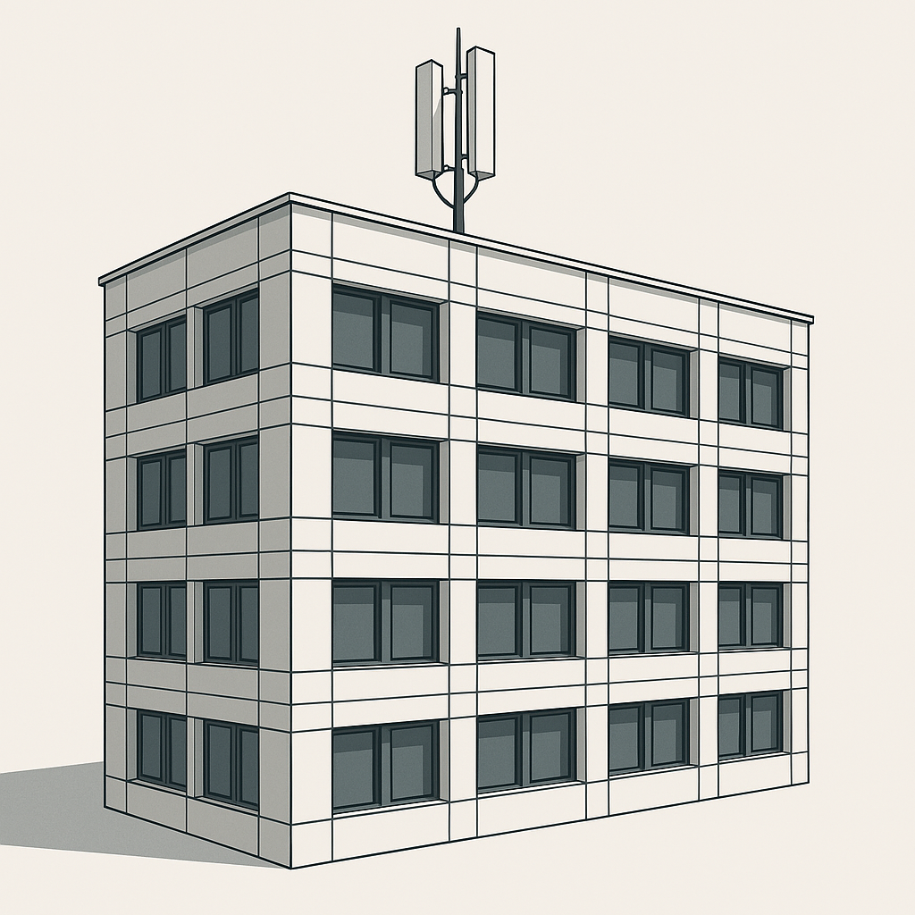
Proposed Solution: Model-Based Site Planning
Site Survey
Schematic Design
Technical Design
Execution & Operations
Scan-to-BIM
Building Permit
BIM
BIM
BIM
Proposed Tasks
Create schematic BIM model
Derivate permit drawings from schematic model
Use schematic model as basis for technical model
Derivate execution drawing from technical model
Use technical model throughout operations
Notes:
To face these challenges, I propose a continuous BIM workflow over all phases. █ This requires a so-called Scan-to-BIM solution that can model the façade of a physical building in BIM. And that’s exactly what I aimed to develop in my research.

Slide 15
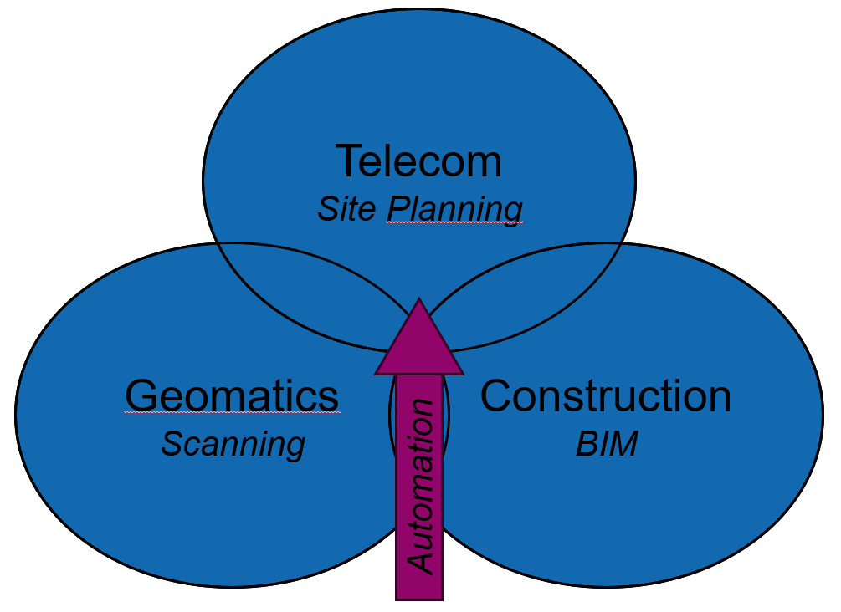
Research Questions
Main Research Question
How can Scan-to-BIM be automated for telecom rooftop site planning?
Sub-Questions
Which steps of Scan-to-BIM can be automated for rooftop site planning?
Which tools enable rooftop Scan-to-BIM automation?
Notes:
The research lies at the intersection of geomatics, construction, and telecommunications.
It applies methods from geomatics and constructions to automate site planning.

Slide 16
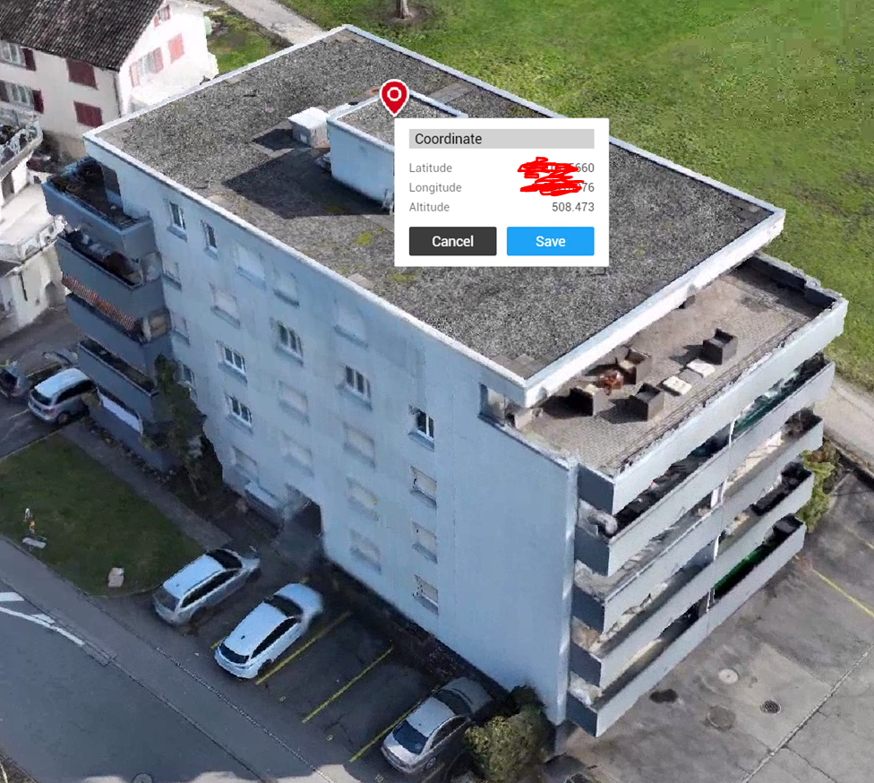
Design Science Research Methodology (DSRM)
Problem Identification
Objectives
Design and Development
Demonstration
Evaluation
Communication
Approach for solving real-world problems by Peffers et al. (2007)
Principles
Structured in six defined steps
Problem-solving through artefact creation
Design and Development
Artefact (tactical level): Framework (from literature)
Demonstration
Application (operational level): Pipeline (from framework)
Case Study in collaboration with
Literature
Artefact
Application
Notes:
As a methodology, I used a framework called Design Science Research Methodology. It consists of six steps and supports real-world problem solving using so-called artefacts.
As an artefact, I developed a framework based on a literature review. On a tactical level, it describes how Scan-to-BIM can be automated.
Based on this framework, I implemented an application, which I then tested in a case study – this building.

Slide 17
Part 2: Research Activities
Notes:
In the second part, I’d like to walk you through the steps in more detail.

Slide 18
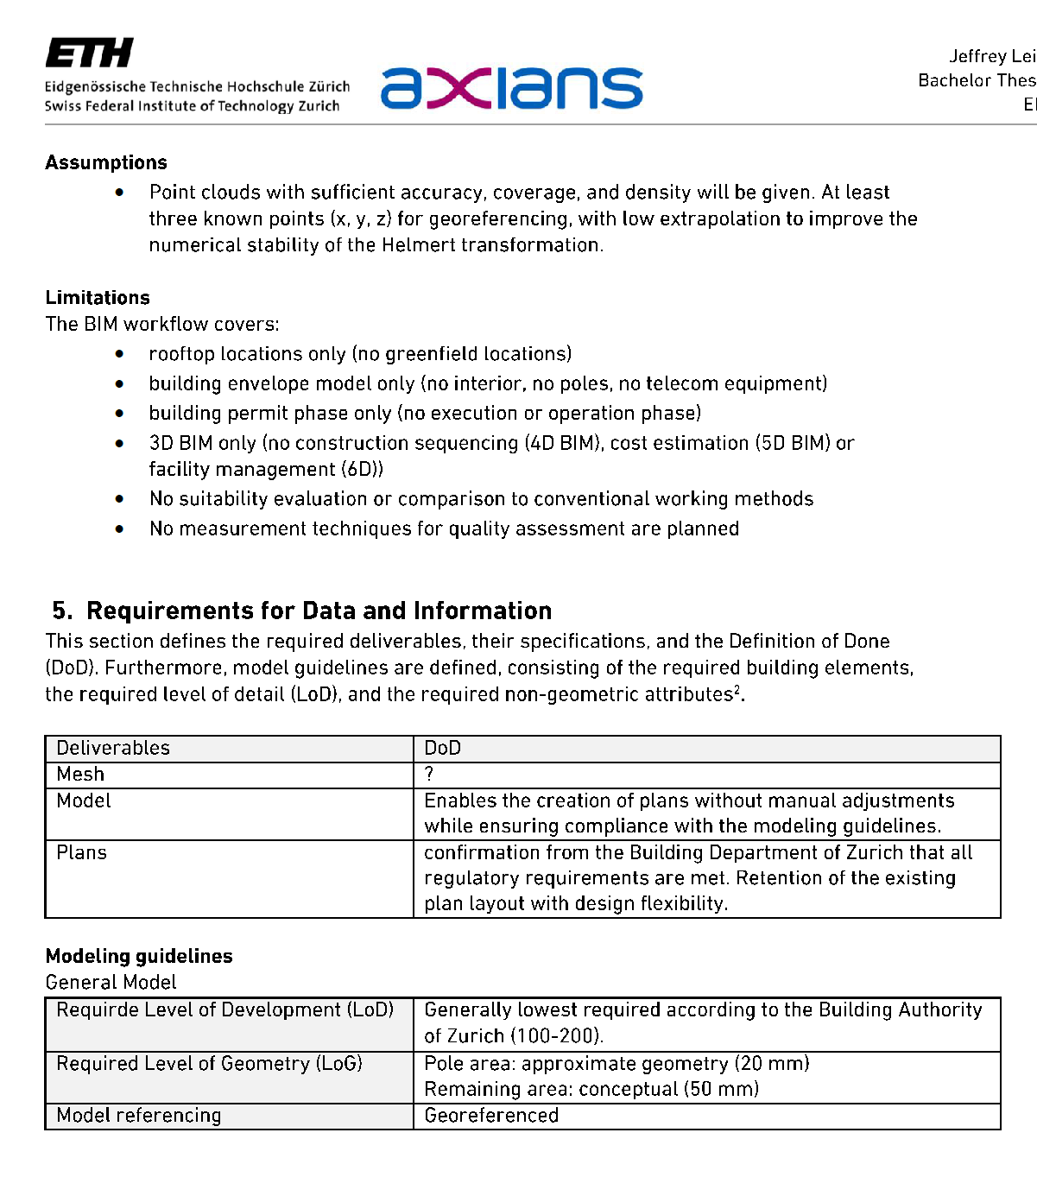
Problem Identification & Objectives
Use of Exchange Information Requirements (EIR) to identify problems and objectives
Problems
Inefficiency of conventional site planning
Lack of commercial solutions for automation
Objectives
Application that converts point clouds into a BIM model
Notes:
At the beginning of the project, I used a BIM tool called Exchange Information Requirements to specify the project with Axians.

Slide 19
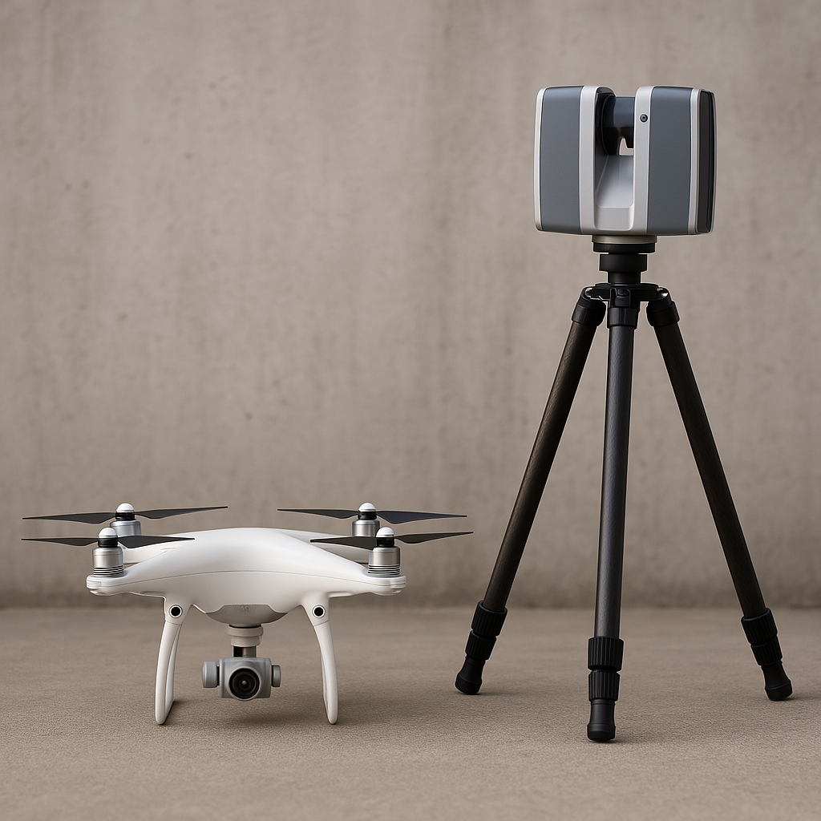
Design and Development
Data Acquisition
Preprocessing
Geometric Reconstruction
Semantic Segmentation
Modeling
Building
Point Cloud
Reality Capture (RC): Convert real-world objects into point clouds
Point cloud: Represent object surfaces as a set of 3D points
Photogrammetry: RC method that uses overlapping 2D photographs
Notes:
After that, I started with the design and development of the framework.
Since I received the reality capture data, its design was not part of my work.

Slide 20
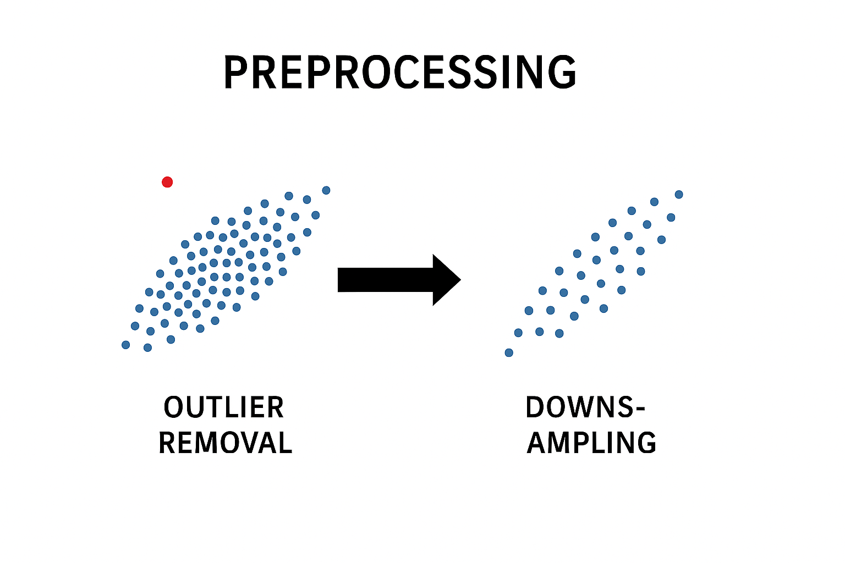
Design and Development
Data Acquisition
Preprocessing
Geometric Reconstruction
Semantic Segmentation
Modeling
Point Cloud
Point Cloud
Preprocessing: Prepare data for further processing
Outlier Removal: Remove far data points Statistical Outlier Removal (SOR)
Downsampling: Reduce the amount of data Voxel Grid Downsampling
Notes:
Then, the framework proposes two methods to prepare the data for further computations.
The first is a statistical outlier removal.
It computes the average distance from each point to its k nearest neighbors. If that distance is more than 2 standard deviations above the global average, the point will be removed.
The second is for downsampling. It creates a voxel grid and retains only one representative point per voxel.

Slide 21

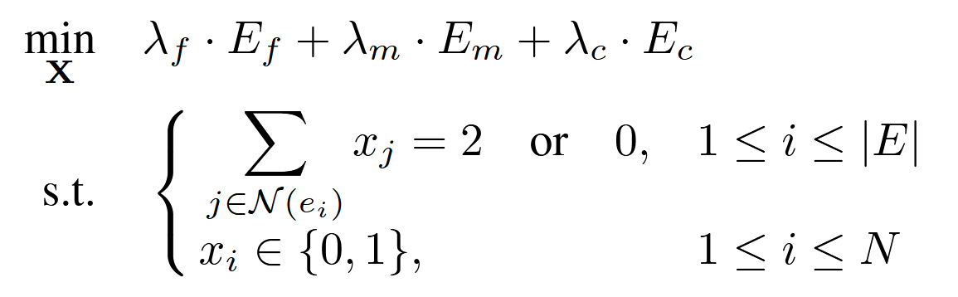
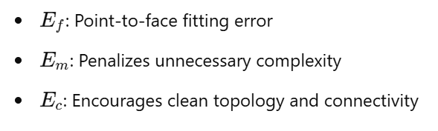
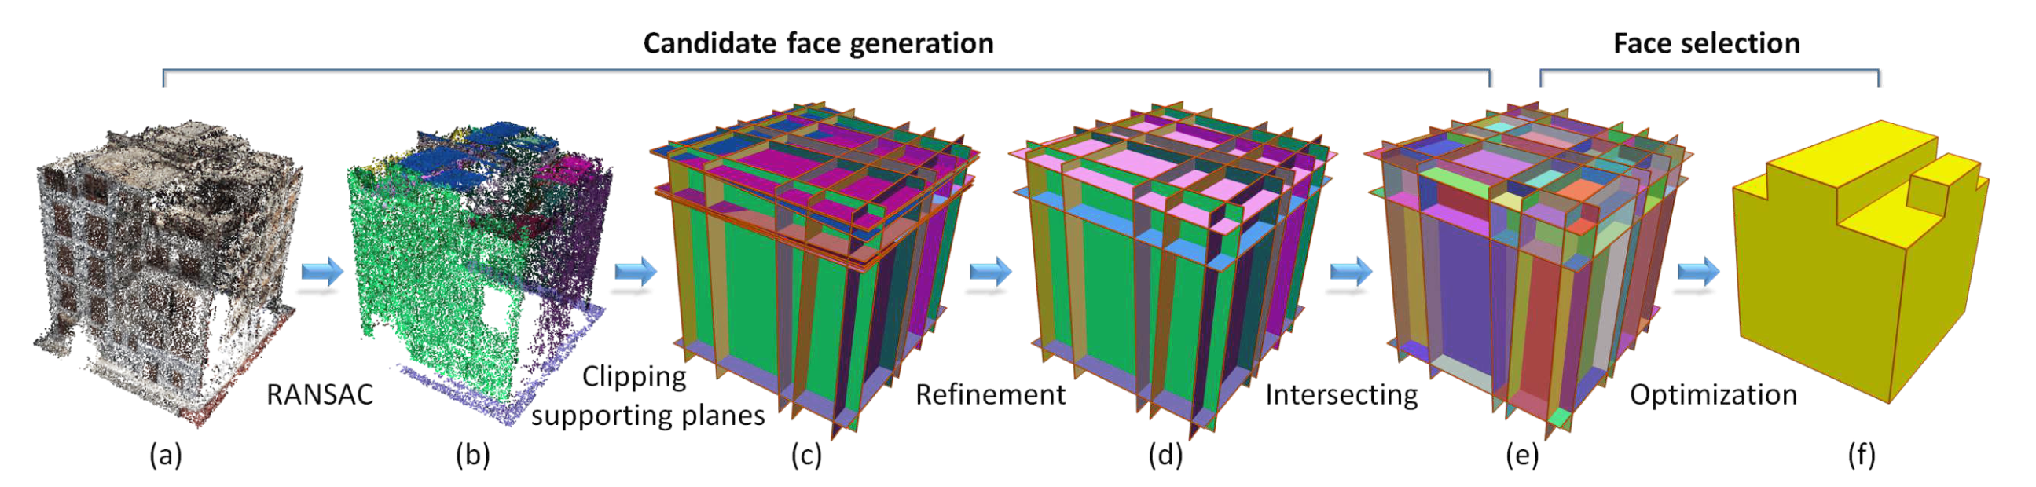
Design and Development
Data Acquisition
Preprocessing
Geometric Reconstruction
Semantic Segmentation
Modeling
Point Cloud
Geometry
Geometric Reconstruction: Extract building surfaces
Example: PolyFit by Nan & Wonka (2017)
Candidate Face Generation: Generate many planar faces RANSAC
Face Selection: Select optimal faces Optimization Problem (Integer Linear Programming)
Notes:
Then, the framework recommends a surface reconstruction method called PolyFit.
It provides the geometry for the later BIM model.
1. First, PolyFit uses the RANSAC algorithm to detect planar faces. 2. After that, it finds the optimal faces with integer linear programming
3. The objective function includes three energy terms.
And with the lambda weights the output model can be controlled.
4. And this constraints ensures that the final result will be a watertight model - so that there are no holes in it. It makes the model quite robust.
It was developed by Liam Nan, a professor at TU Delft. He was really kind and supported me with the implementation.

Slide 22
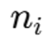
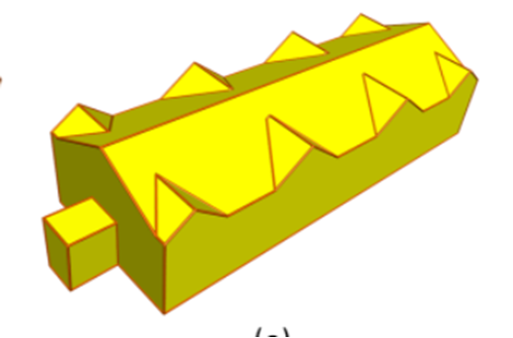
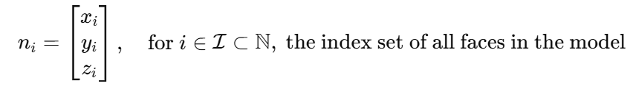
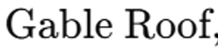
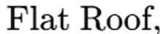
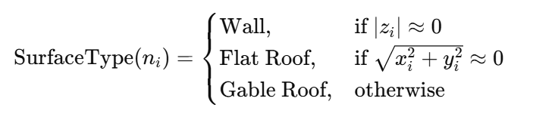
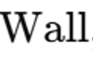
Design and Development
Data Acquisition
Preprocessing
Geometric Reconstruction
Semantic Segmentation
Modeling
Geometry
Semantic
Semantic Segmentation: Classify building elements
Feature Extraction: Select useful information from data Normal Vector
Classification: Label features Rule Based Classification
Notes:
After that, the objects still needs semantics.
1. For that, the framework recomends to compute the normal vector of each face.
2. Then, this vector can be used as a rule-based classification metric.
So, at the end we have the geometry and semantic for each face.

Slide 23
Design and Development
Data Acquisition
Preprocessing
Geometric Reconstruction
Semantic Segmentation
Modeling
Drawings
Geometry
Semantic
BIM Model
Modeling: Merge geometry and sematic into a BIM model
Automated Modeling: Convert mesh into a basic IFC model ifcopenshell
Manual Modeling: Add architectural elements in BIM software windows, doors, balconies, roof structures, topography, radio site components, …
Drawing Generation: Derivate and dimension 2D drawings plan view, front elevation, side elevation
Notes:
The final step is then the modeling.
First, I propose converting the mesh into a basic IFC model that can be opened in BIM software.
In the BIM software the model should then be refined manually by adding architectural elements like windows.

Slide 24
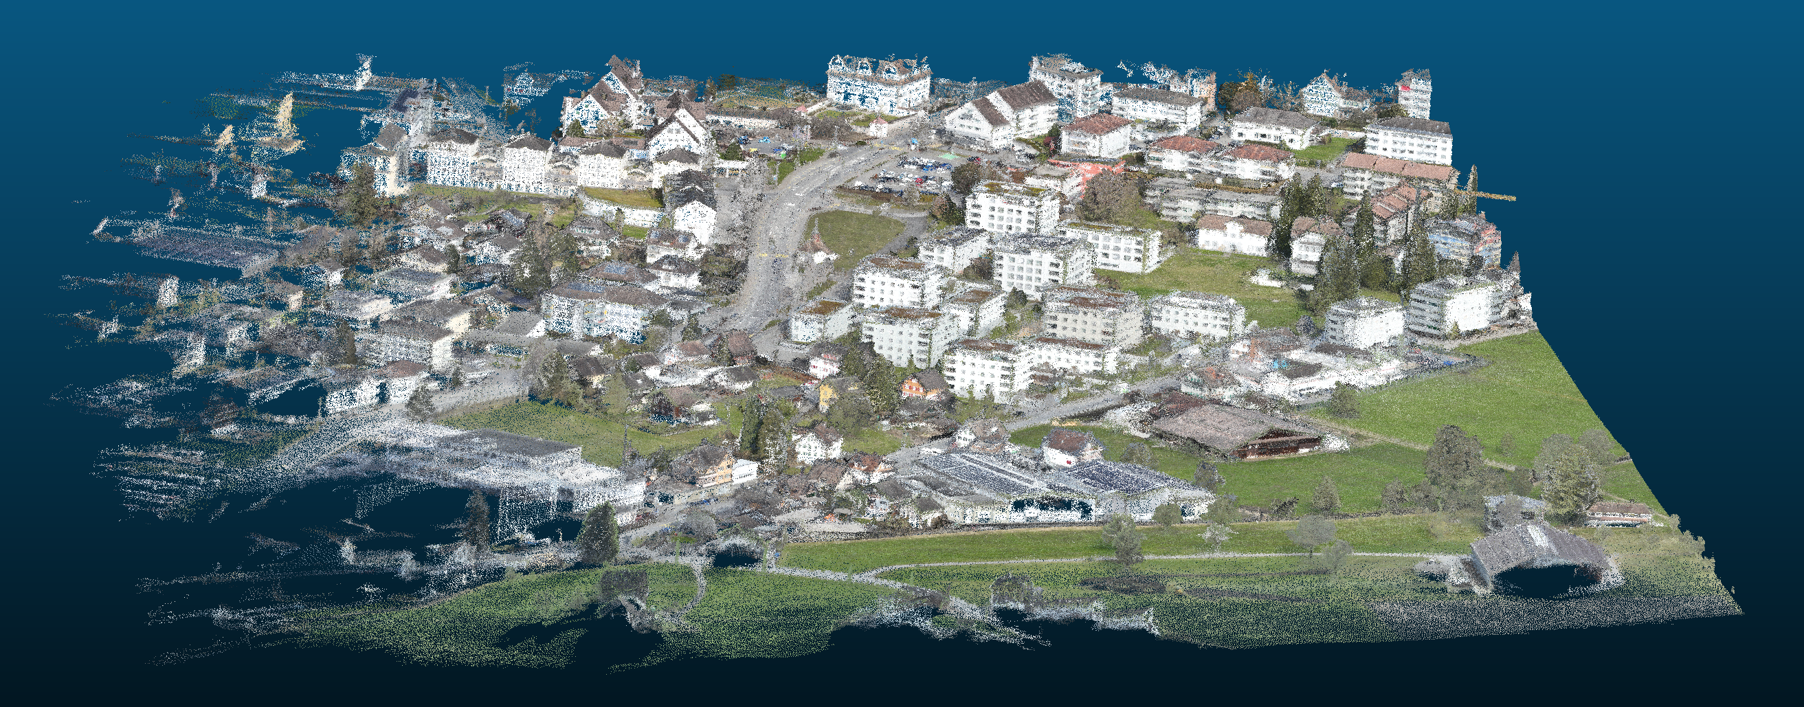
Demonstration
Applying the developed framework to a real-world project.
Provided point cloud
Site
Notes:
That recipe-like framework I then implemented in python.
From Jean-Charles, I got this point cloud and the goal was to extract the drawings for that building.

Slide 25
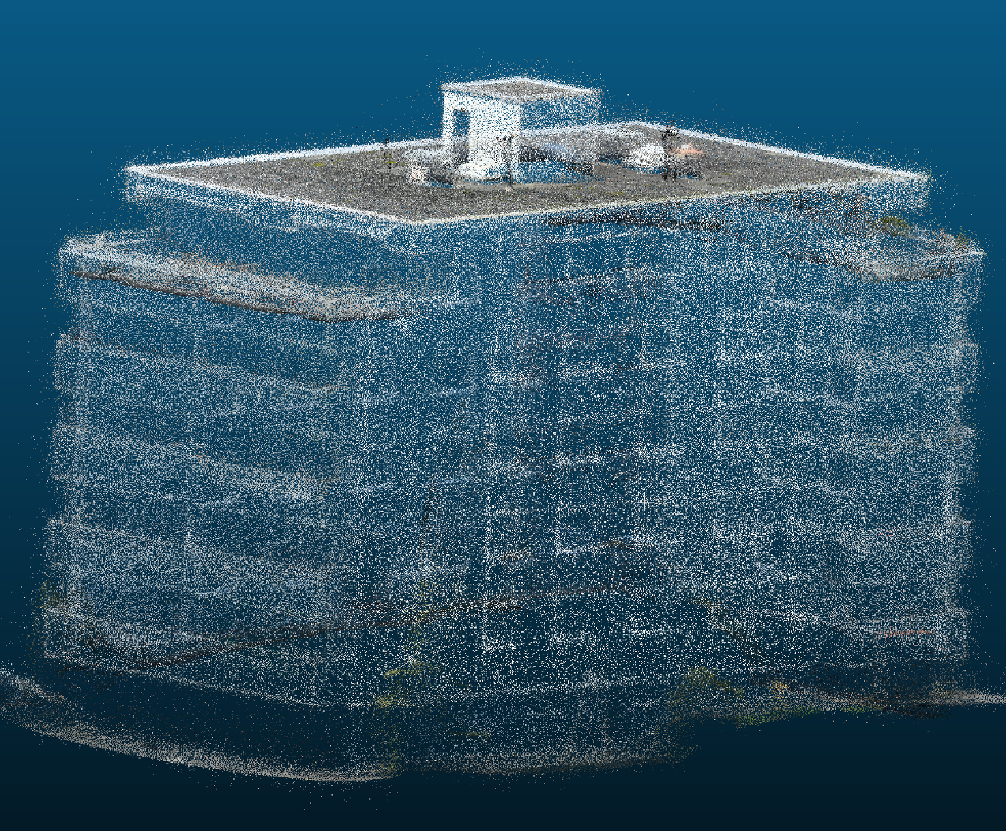
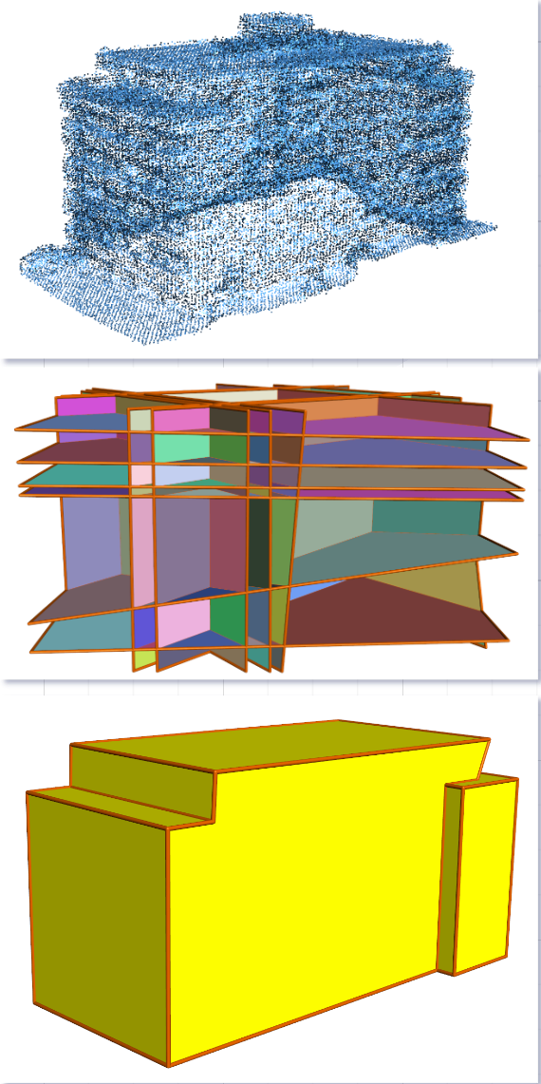
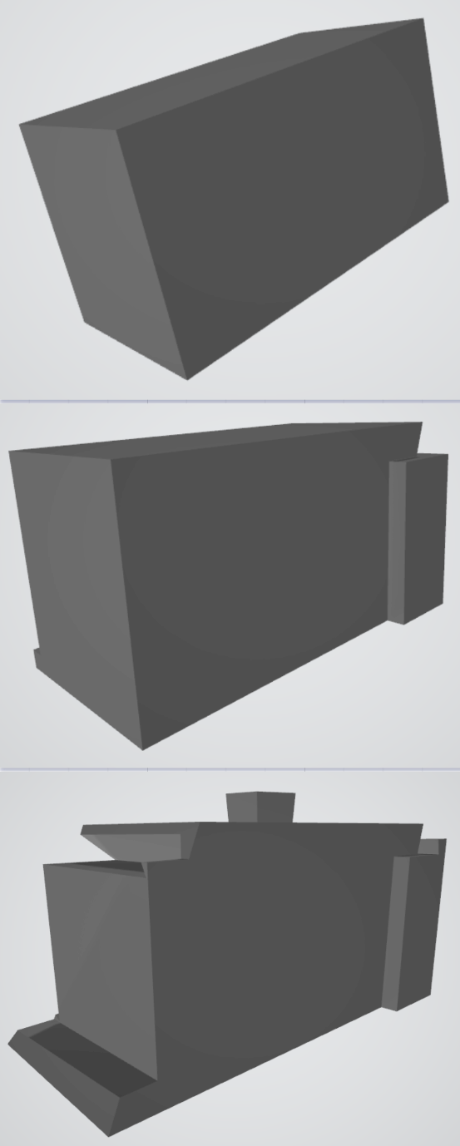
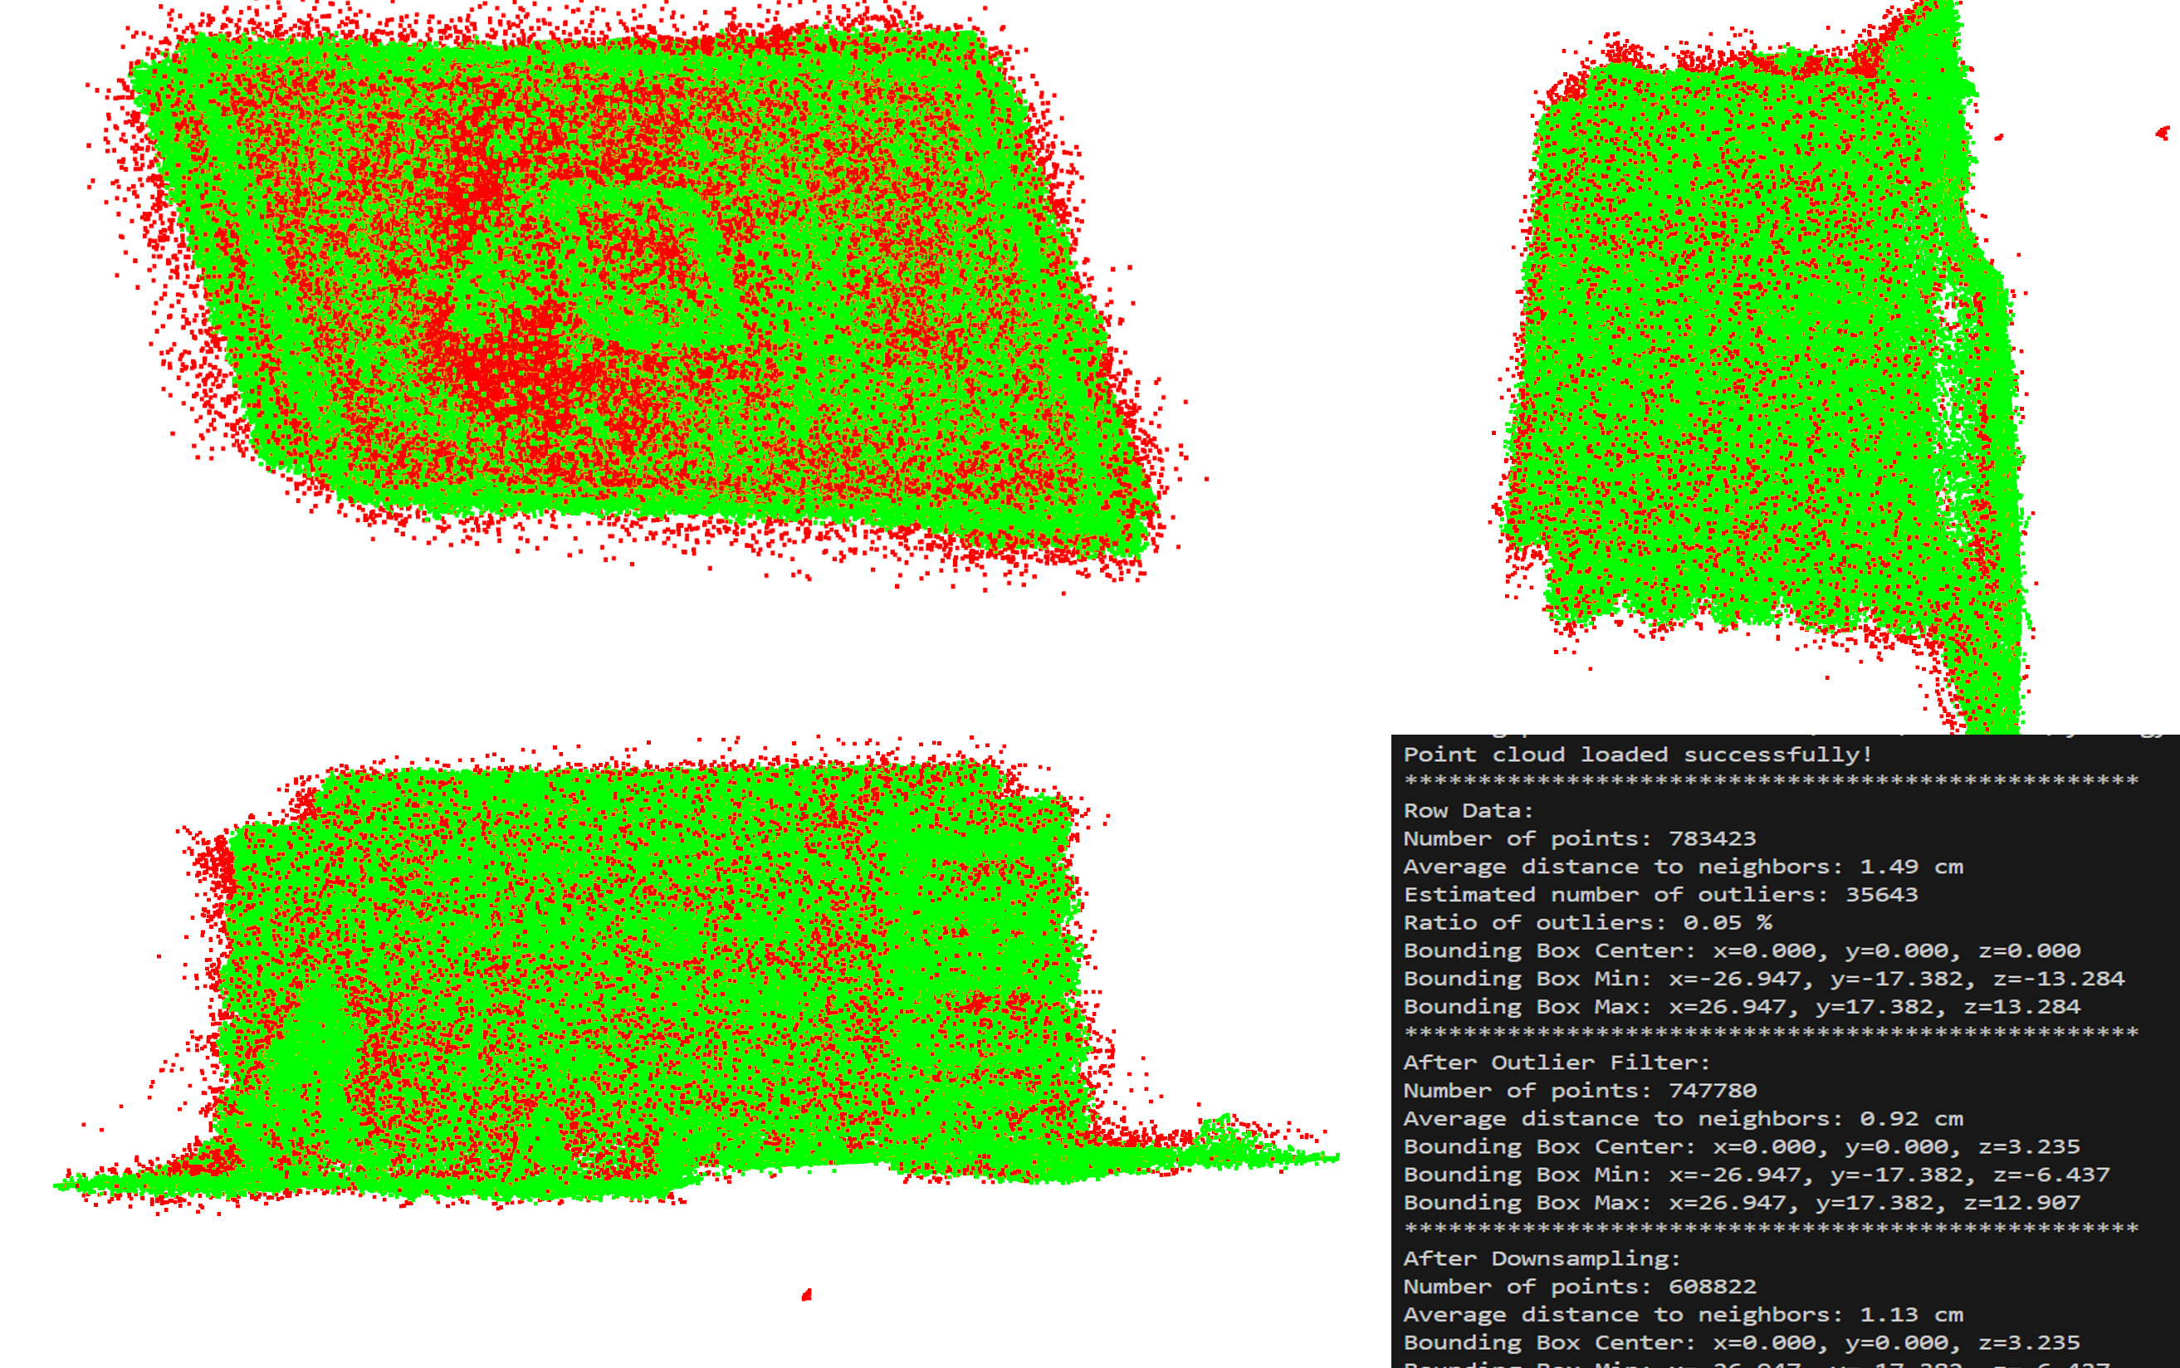
Demonstration
Notes:
█ First, I extracted the required building from the given point cloud using CloudCompare.
Then, I passed it into my application.
█ It preprocesses the data and applies the geometric reconstruction.
Since the reconstructed mesh depends on various parameters, it’s output is quite unpredictable.
█ Therefore, I use a brute-force approach that generates about 20 different meshes.

Slide 26
Demonstration
Notes:
From which the user then can choose the best candidate.

Slide 27
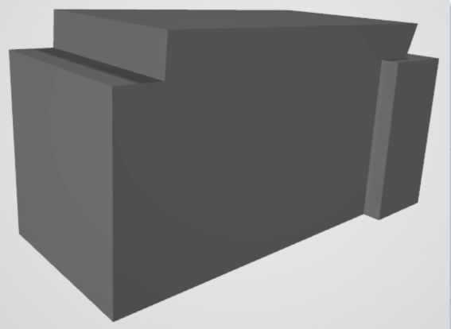
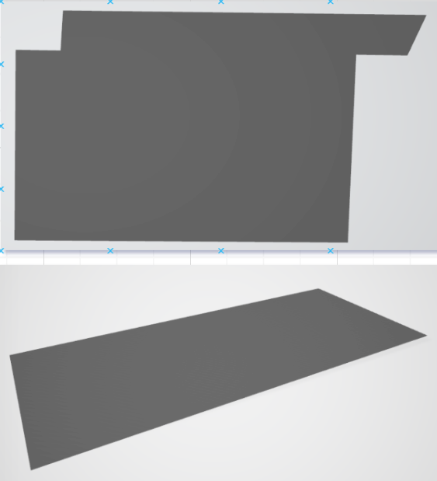
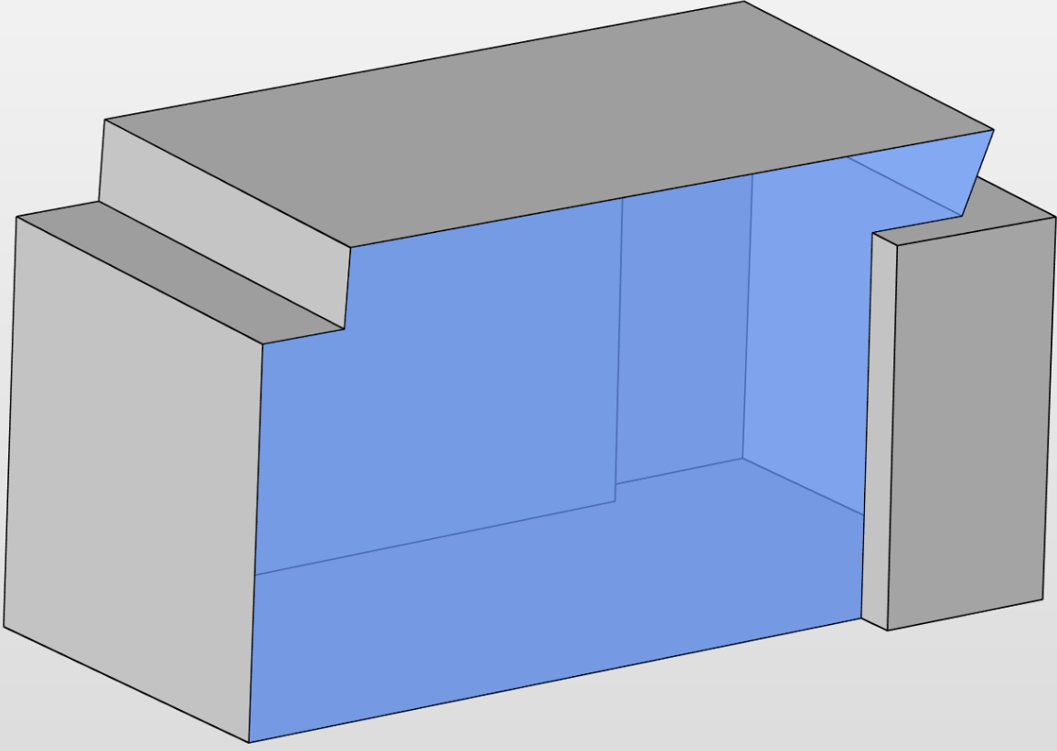
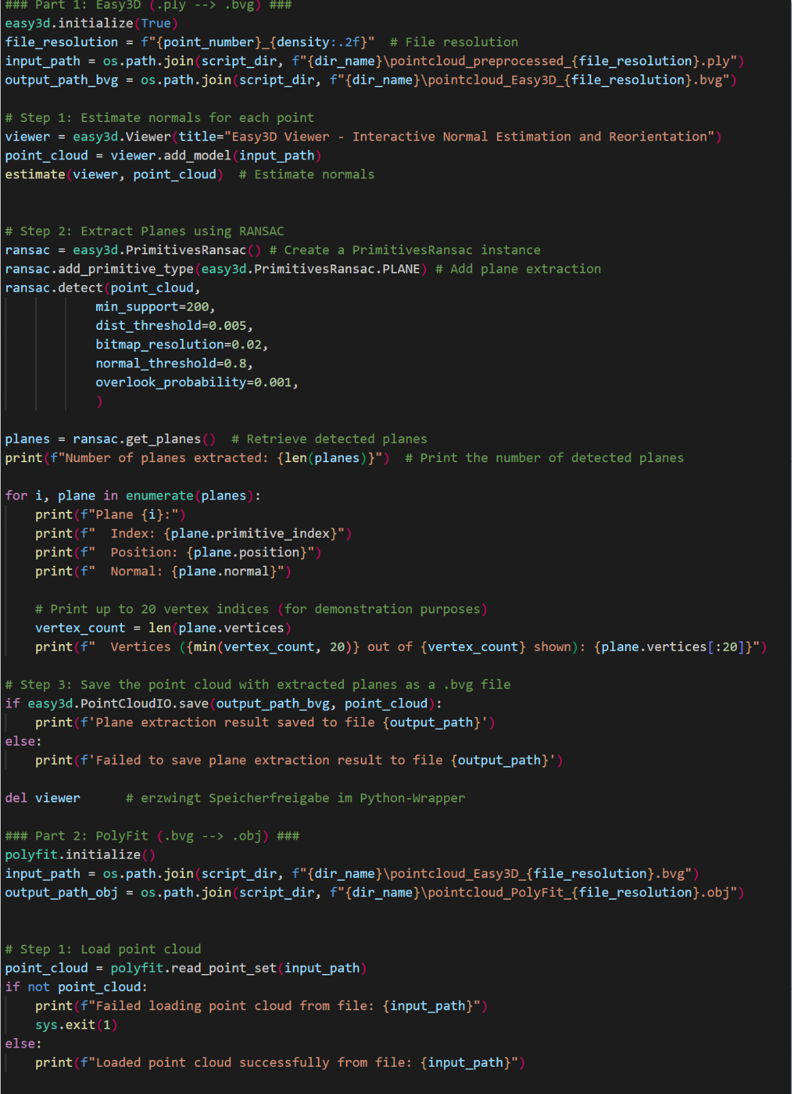
Demonstration
Notes:
This candidate is then sent back to the application.
█ Which extracts and labels every single face.
█ In the end it converts the mesh into a IFC-file, that can be opened in Revit.

Slide 28
Demonstration
Notes:
To convert the IFC elements into native Revit elements, I used Dynamo.

Slide 29
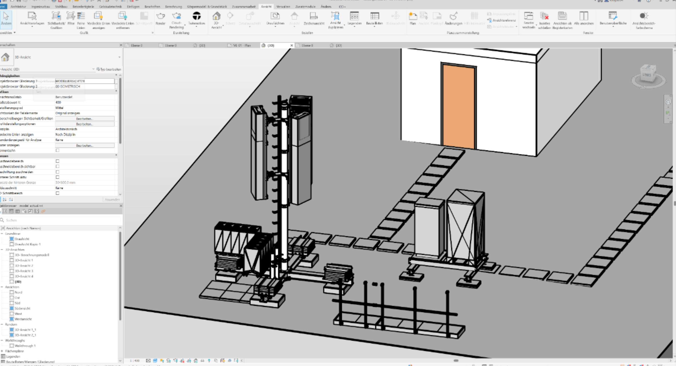
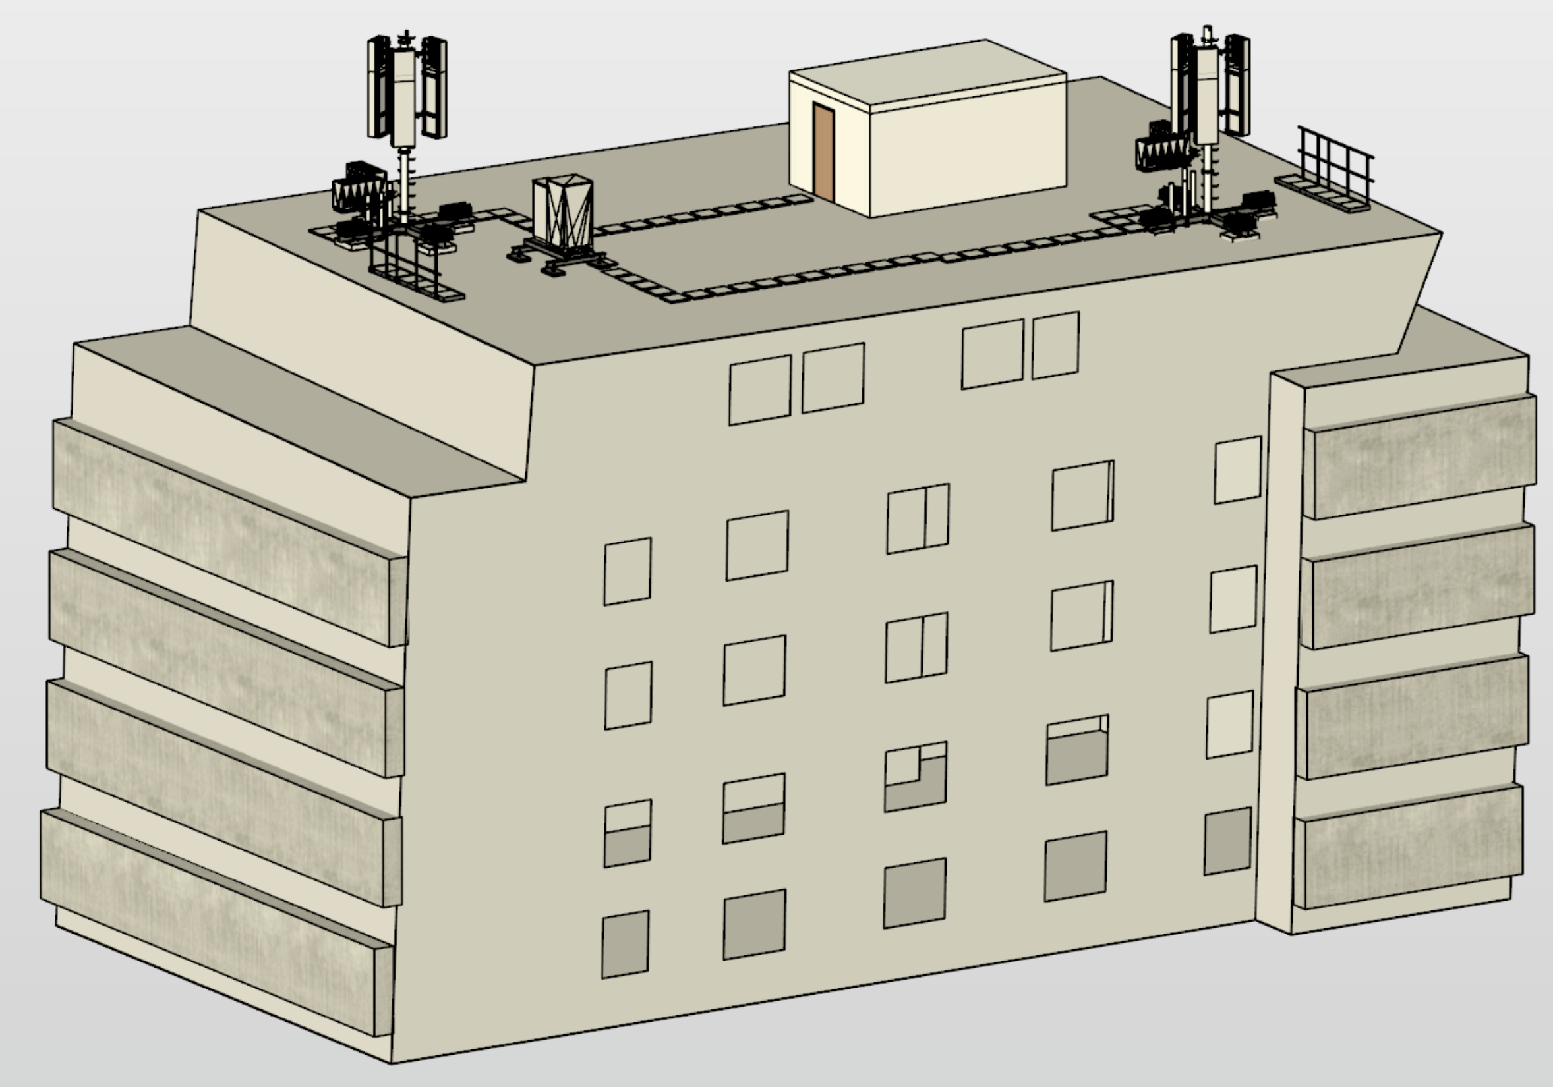
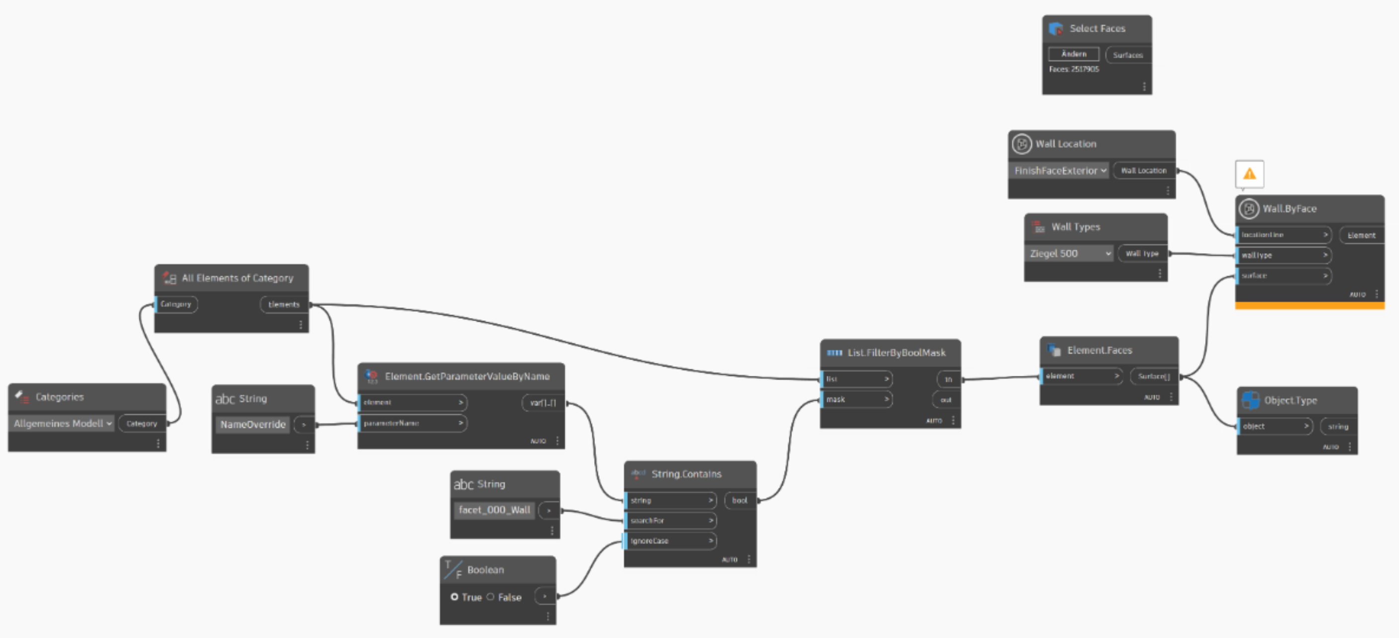
Demonstration
Notes:
Then began - the for me hardest part - the manual modeling.
█ I had never worked with BIM before, and in the beginning, it was quite overwhelming.
█ But then, somehow, I managed to refine the model — and from that, I was able to generate my final outputs.

Slide 30
Demonstration
Notes:
I think the drawing looks already pretty decent.
It should be sufficient for a permit application.

Slide 31
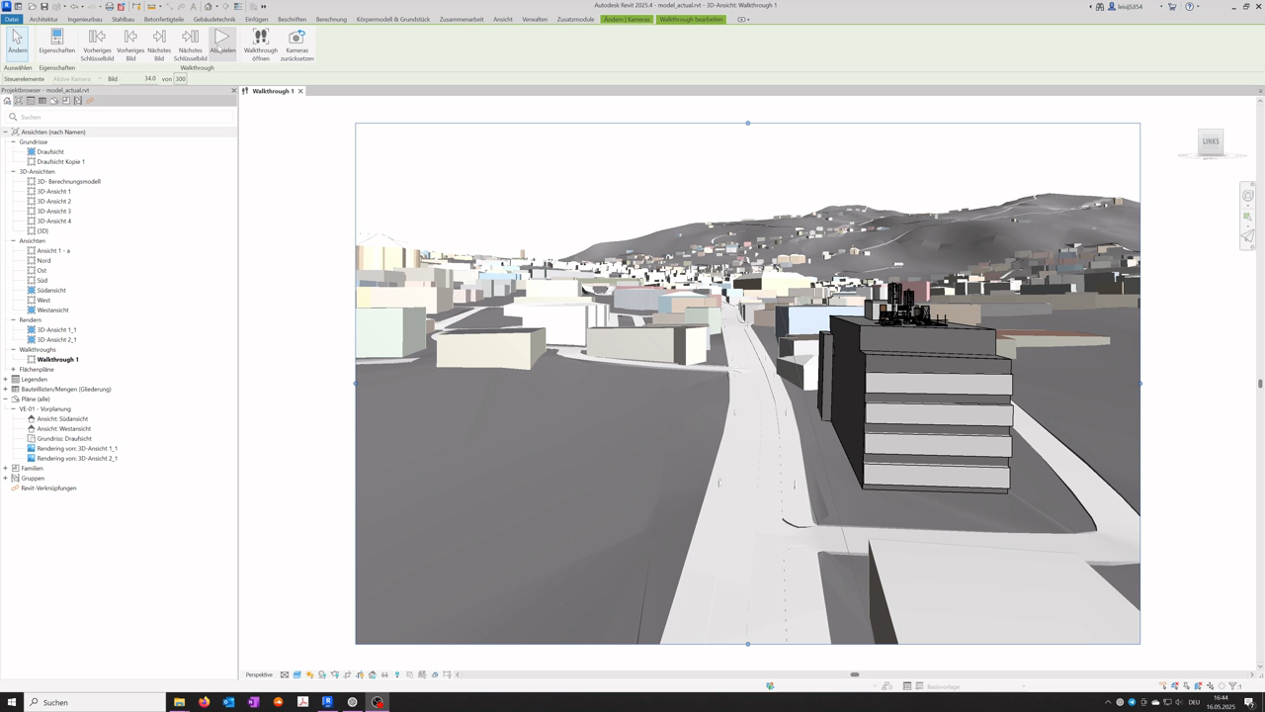
Demonstration
Animation
Notes:
For a better visualization I then created this little animation.
I was not able to render it, so the texture looks still a bit shabby.

Slide 32
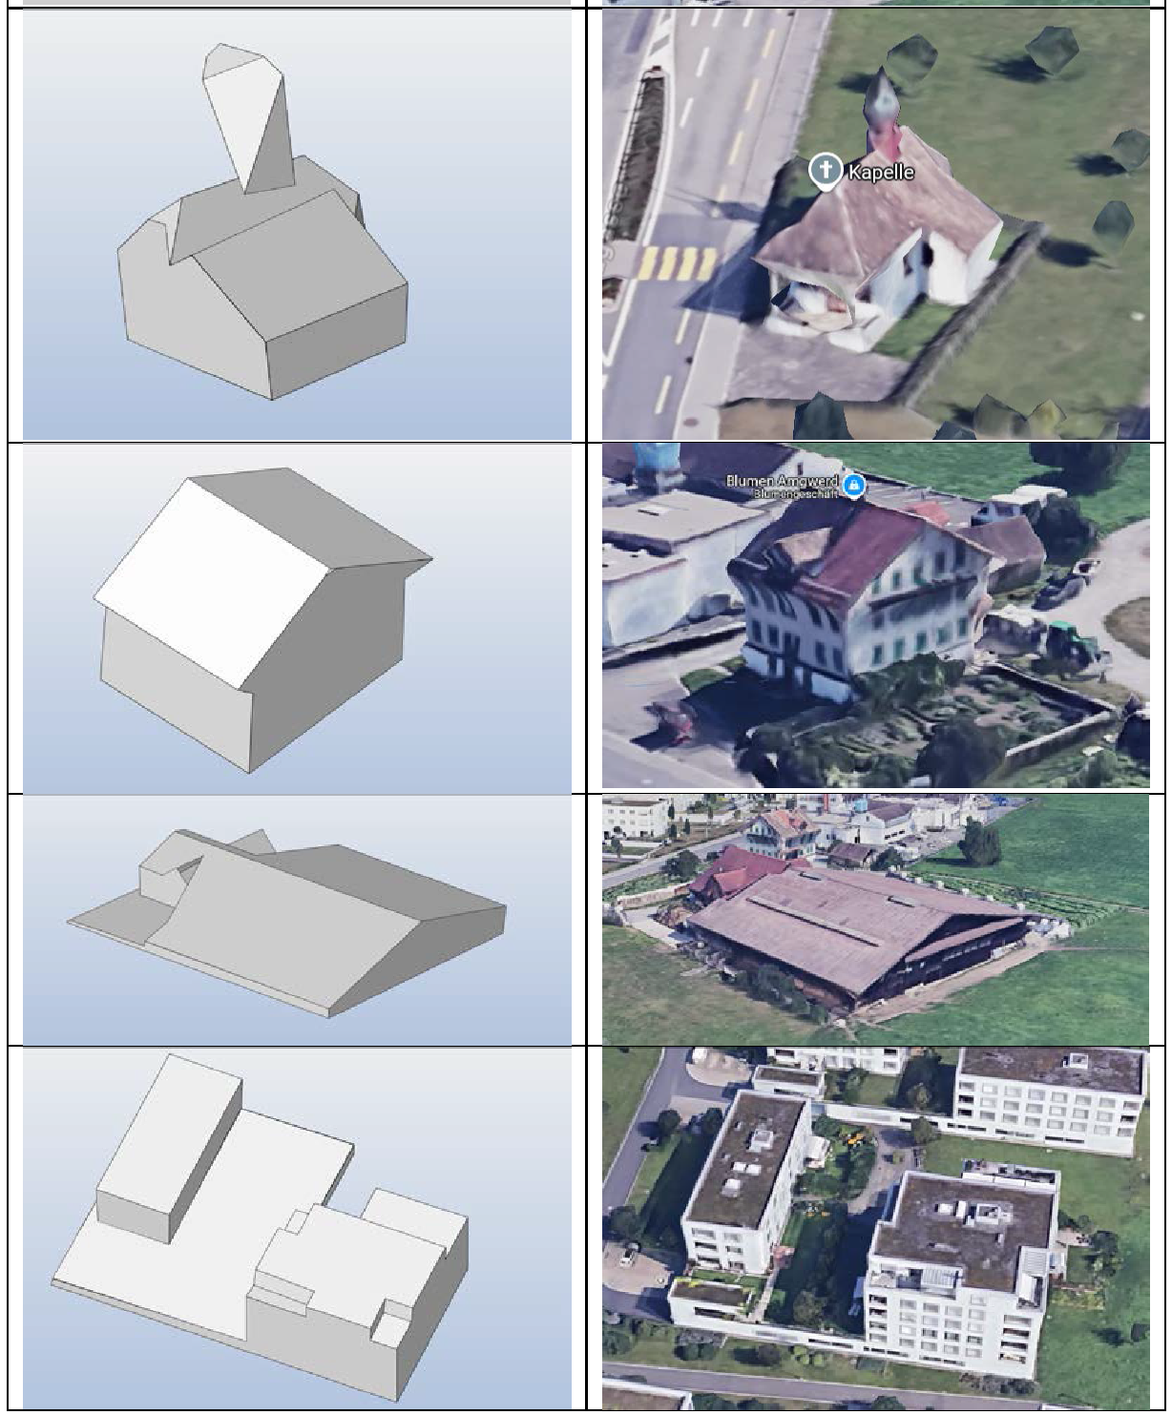
Evaluation
Study Design Limitations:
No comprehensive evaluation (excluded from beginning due time constraints).
Following aspects were assessed:
PolyFit Runtime (for different conditions)
Generalizability (for different buildings)
Model quality (based on subjective observations)
Generalizability
Notes:
The next step was the evaluation.
Since a comprehensive evaluation is very time-consuming, we excluded it from the beginning.
Hower, I tested the generalizability to other buildings.
Apart from the little church, I would say the results were acceptable.

Slide 33
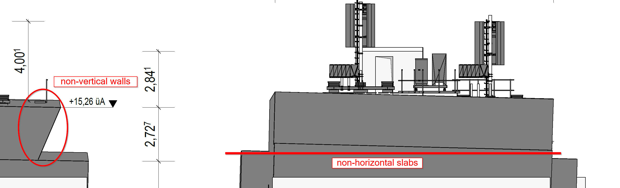
Evaluation
Limitations
Geometric Reconstruction
No curved geometries possible
Low precision (high variability in results) → low accuracy (not validated)
Geometric imperfections (non-orthogonality) increase modeling effort
Notes:
There are still several limitations.
Most of them are related to geometric reconstruction.
Since the precision OR the repeatability of the mesh generation is low, we can assume, that the overall accuracy can’t be very high.
█ In addition, there are geometric imperfections.
Right angles in the physical world are not always correctly represented, which makes working in Revit even more difficult. And it can also limit the functionality of some specific BIM elements.

Slide 34
Evaluation
Limitations
Geometric Reconstruction
No curved geometries possible
Low precision (high variability in results), questionable accuracy (not validated)
Geometric imperfections (non-orthogonality) increase modeling effort
Level of automation
Details (windows, roof structure, …) still require manual modeling
Deployment
Python-based algorithm requires significant setup effort (many dependencies)
Notes:
Further limitations are the still required manual modeling and the high setup effort for the application deployment.

Slide 35
Evaluation
Results
A Scan-to-BIM framework was successfully developed and implemented.
A high degree of automation could be achieved.
Due to current limitations, practical use remains unlikely without additional refinements.
Notes:
█ In conclusion we can say, that a Scan-to-BIM framework was successfully developed and implemented.
█ A high degree of automation could be achieved.
█ However, practical use without further refinements remains unlikely.

Slide 36
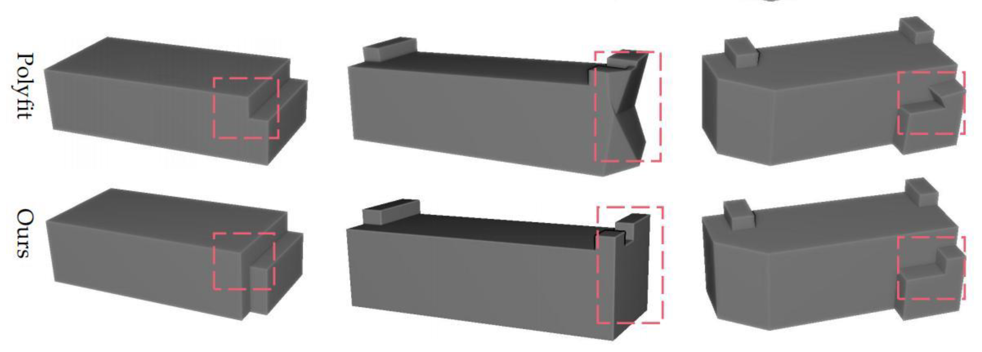
Evaluation
Future Work
Geometric Reconstruction
Ground truth validation of main surfaces is necessary
Evaluate other promising geometric reconstruction algorithms (accessibility remains unclear)
Wang Feng et al. Reconstruction of LoD-2 Building Models Guided by Façade Structures from Oblique Photogrammetric Point Cloud (2023)
Notes:
To address the limitations, I propose some future work:
For the geometric reconstruction there are other promising methods.
Especially approaches that use Manhattan assumptions could be interesting. Because this could help to better handle geometric imperfections.

Slide 37
Evaluation
Future Work
Geometric Reconstruction
Ground truth validation of main surfaces is necessary
Evaluate other promising geometric reconstruction algorithms (accessibility remains unclear)
Level of automation
Use of neural networks for automatic object detection (Master’s thesis incoming ☺)
Deployment
deploying as a web application (.ply to .ifc)
Notes:
The level of automation could be further increased with neural networks.
I think that would be an interesting topic for a master thesis.
█ And for the deployment I would just propose a simple web server.
The user could upload a point cloud via browser and would then receive the corresponding IFC model.

Slide 38

Communication
Sharing Results The results were presented to project stakeholders on 26.05.2025 at ETH Zürich.
Further resources are publicly available via GitHub:
Final thesis (available from 15.06.2025)
Final source code (expected end of July)
Questions or suggestions? Feel free to contact me at: leisij@student.ethz.ch
GitHub
Notes:
All findings will be accessible via GitHub in the near future.
But probably without a proper technical documentation.

Slide 39
Q&A
Thank you for your attention
Many thanks to my supervisors for their guidance during this project:
Oceane Durand-Maniclas (ETH)
Kasimir Forth (ETH)
Jean-Charles Schaegis (Axians)
Notes:
Finally, I would like to thank the CEA Lab — and especially my supervisors — for giving me the opportunity to bring in my own thesis topic.
I’m from a different institute and I don’t take it for granted.
And now I’m interested to hear your opinions. Thank you.

